Slide 1
REPORTING ICPC INITIATIVES: NEIP, CEPTI, SEXUAL HARASSMENT
BEING
A PRESENTATION BY
MOHAMMED ASHIRU BABA, fsi, FCIA, MNIM, ANIPR
DIRECTOR
PUBLIC ENLIGHTENMENT AND EDUCATION, ICPC
AT A
TWO-DAY REFRESHER WORKSHOP FOR REPORTERS COVERING THE ACTIVITIES OF INDEPENDENT CORRUPT PRACTICES AND OTHER RELATED OFFENCES COMMISSION (ICPC) ORGANIZED BY THE PUBLIC ENLIGHTENMENT AND EDUCATION DEPARTMENT, ICPC
HELD AT THE ICPC AUDITORIUM
MONDAY, 19TH AND TUESDAY 20TH JUNE, 2023

Slide 2
OBJECTIVES OF THE PRESENTATION:
The presentation seeks to achieve the following
objectives:
To enlighten reporters on the major anti-corruption initiatives embarked upon by ICPC;
To enhance the quantity and quality of media reportage of ICPC’s anti-corruption activities;
To further cement the cordial relationships between ICPC and the media;
To encourage some element of investigative journalism, away from the traditional handout- oriented news - (he say…he added) around anti-corruption activities.

Slide 3
FOCUS
This presentation focuses on non – enforcement functions and activities of ICPC and how to promote media reportage around such activities.
At the end of the presentation, reporters would be better equipped on how to report on preventive and mobilization activities of the Commission.

Slide 4
INTRODUTION
Between 2019 and date, ICPC has either introduced new projects and strategies or has improved existing strategies, thereby injecting fresh ‘blood’ to the tempo in the fight against corruption.
Notable among such strategies are:
The Ethics and Integrity Compliance Scorecards administered on MDAs through the various anti-corruption monitoring units;
The National Ethics and Integrity Policy, launched by former President Muhammadu Buhari in September, 2020;
The Constituency / Executive Projects Tracking Initiative (CEPTI);
The curbing of tax - related illicit financial flows and
Anti-sexual Harassment (in educational institutions) Policy initiated by ICPC and Gender Mobile Initiative with the support of the Ford Foundation.

Slide 5
INTRODUCTION
Our discussion this morning is on Stimulating Media Reportage of ICPC’s anti-corruption initiatives notably the National Ethics and Integrity Policy (NEIP), the Constituency / Executive Projects Tracking Initiative (CEPTI) and Anti sexual Harassment (in educational institutions) Policy in conjunction with Gender Mobile Initiative and supported by the Ford Foundation.
I understand that someone else would take us on Ethics and Integrity Compliance Scorecards. If time permits, I shall touch on illicit financial flow with particular reference to tax – related frauds. Remember, the Chairman of ICPC, Professor Bolaji Owasanoye, SAN, OFR is the current Secretary, Africa Inter-agency Committee on Curbing Illicit Financial Flows

Slide 6
INTRODUCTION
Ordinarily, the activities and achievements of ICPC, particularly in recent years should attract unprecedented media coverage. We encourage the media to visit the ICPC’s website www.icpc.gov.ng and other social media handles as highlighted at the last slide of this presentation, to see for themselves the much ICPC had accomplished in recent years.

Slide 7
THE NATIONAL ETHICS AND INTEGRITY POLICY (NEIP)
The National Ethics and Integrity Policy, was developed by ICPC in collaboration with OSGF and NOA, to enhance values of integrity and tackle corruption in the society.
It was developed in response to the many damaging effects of corruption in both public and private sectors, with a view to help restore and revitalize these sectors.
ICPC had earlier developed a National Values Curriculum (NVC) for teaching of values in schools to young Nigerians. The National Ethics and Integrity Policy builds on the basics of the Curriculum, to entrench positive values in the society.

Slide 8
LEGAL FRAMEWORK OF THE NEIP
The Policy draws its contents from:
The Constitution of the Federal Republic of Nigeria 1999 as amended
The Corrupt Practices and Other Related Offences Act, 2000
National Orientation Act, Cap N64 LFN 2004
United Nations Convention Against Corruption (UNCAC) (2003) and other relevant laws.
Codes of Ethics of professional associations such as the Nigerian Union of Journalists, Nigerian Bar Association, COREN, Teachers Registration Council of Nigeria, etc.

Slide 9
Fundamental Principles
Obligates all Nigerians, and everyone who resides within the borders of Nigeria or who relates with the country one way or the other, to commit to uphold these core values.
The violation of any of these principles is actionable by relevant government agencies both at the federal and state levels.
The principles of the National Ethics and Integrity Policy are to be interpreted in line with provisions of federal laws and regulations, the Nigerian Constitution, standing rules and codes of conduct of professional bodies and statutory rules guiding public and private institutions.

Slide 10
Purpose of the Policy
To strengthen efforts at positive national transformation. This will be possible as citizens and those who relate with Nigeria imbibe and embody the core values.
To help the country reach national development goals as we reframe the meaning of national purpose.
To save the country from an erosion of ethics and the collapse of values.
To encourage citizens to put Nigeria above all else. It will help diminish the need for “corruption as a survival strategy”. This will “enhance the survival of the weak and control the power of the strong”.
To open up an ongoing dialogue as to how to refine behaviours to bring out the best in ourselves.

Slide 12
1. Human Dignity
Human beings have an inherent worth that must be respected and never violated.
Articles of the Value include the following enshrined in the Nigerian Constitution:
Right to Life, Freedom of Movement, Speech, Association, Equality before the Law, Fair Hearing, Freedom of Expression, Freedom from discrimination, etc.
Practical application: Place human dignity above profit in employment.
Do human lives really matter? Are all lives seen as valuable?

Slide 13
2. Voice and Participation
Voice refers to a right to express an opinion and influence a decision.
Participation is an act of taking part in an activity or event.
Articles on this value include:
Democratic Principle, Good governance, Leading by Example, Representation, Non-discrimination, Fair Hearing, etc.
Practical Application:
Every person has the right to be represented in governance, in order to air their views on how things should be done.
Every person may report misconduct or violations of the ethics and integrity policy to any anti-corruption agency or law enforcement agency.

Slide 14
3. Patriotism
Love for one’s country and the willingness to defend it.
A sense of nationhood, loyalty, solidarity, national pride, sense of belonging, respect, tolerance, dedication, etc.
Lack of patriotism results in dysfunctional behaviour of the citizens and this is worsened by the challenges of corruption, intolerance, tribalism, etc.
Practical Applications of Patriotism:
Public display of the Nigerian Flag and Coat of Arms. Being law abiding, respecting others right, speaking well of the nation.
Recite the National Pledge at meetings

Slide 15
4. Personal Responsibility
Personal responsibility – a sense of duty to help provide solutions within a group
Objectives of Personal Responsibility include:
Improve discipline, respect, commitment and self-control in the nation at large
Enhance trust and reliability especially in the private sector towards providing goods and services that meet minimum acceptable international standards in demonstration and reflection of personal responsibility to consumers and other stakeholders
Enhance quality of political representation amongst elected and appointed public
Practical Application: Exhibiting dependability and reliability in fulfilling duties and responsibilities

Slide 16
5. Integrity
To act with Integrity means to act consistent with established standards, principles, expectations, and values regulating a particular undertaking. Integrity entails doing the right things and doing things right consistently and acting in complete compliance with accountability standards and the requirements of moral responsibility.
Practical Examples of Integrity
Honesty: Being truthful and straightforward in our dealings with one another.
Courage: Upholding moral strength to venture, persevere, and withstand danger, fear or difficulty in the conduct of our lives and in the pursuit of the public and national good, irrespective of the cost to us.

Slide 17
INTEGRITY (CT’d)
Mutual Accountability: We pledge to be accountable for our actions and to answer to any question raised by our actions or inactions.
Fear of God: We shall all live under the fear of God as the guide to our interactions with each other and with others.
Others include: Honour, Transparency, Faithfulness, Commitment, Self-Control, Honest Custodian of Communal Goods

Slide 18
6. National Unity
Nigeria: a nation with 250 ethnic groups, 2 major religions and more than 500 languages and dialects. It is imperative for all ethnic nationalities to have a sense of commonality, belonging and of being united as a people in one sovereign nation.
National Unity means having the sense of oneness of Nigeria as a nation, of belonging to a nation where all citizens are equal regardless of tribe or origin.
Objectives of the Value include to create a sense of togetherness in all citizens and convince citizens that their interests will always be represented in national affairs especially as they have the right and own the power to elect their representatives.

Slide 19
NATIONAL UNITY (CT’D)
Enforcement: Anyone or group that works to undermine or destroy the unity of the country should be considered to have committed a treasonable offence and shall be sanctioned accordingly.
Practical Application: Emphasize
what unites Nigerians rather than
what divides them.

Slide 20
7. Professionalism
Professionalism refers to the high standards expected from a person who is well-trained in a particular job. It refers to commitment to excellence in service.
Legal Foundation: The Public Service Rules, Code of Conduct for Public Officials, Professional Codes of Ethics, etc.
Objectives: Excellence and high quality standards in the performance of service.
Practical Application: Accountability, Avoidance of Conflict of Interest, Guidance in Gift acceptance, Impartiality, etc.

Slide 21
Building Partnerships and Encouraging Nigerians to Own and Drive the National Ethics and Integrity Policy

Slide 22
IMPLEMENTING THE POLICY using the National Action Plan (NAP) and Consequence Management Template (CMT)
A National Action Plan (NAP) has been developed for the implementation of the Policy.
The National Action Plan (NAP) identifies 16 stakeholder groups and these include:
Religious leaders
Women groups
Youth groups
The media
Civil society groups
NEIP also has a Consequence Management Template (CMT). We shall examine both the NAP and the CMT
Traditional rulers
Professional Organizations
People with Disability etc

Slide 23
The National Action Plan of the National Ethics and Integrity Policy

Slide 24
For each group, the NAP identifies
Generic Pain Points which are those problems faced by the stakeholder groups in trying to maintain Integrity;
Generic Incentives which are things that should motivate each stakeholder group to want to comply with the Policy;
Generic Drivers and champions of the Policy that would compel stakeholders to comply; and
Generic Retarders: those issues that would tend to work against compliance with the Policy.

Slide 25
Identifies the objectives of engaging with them
Activities specifically tailored to that group
Key Indicators of success within the group
Timelines
Responsible parties
Communications channels to be used to reach out to them.

Slide 26
Religious Leaders and Traditional Rulers
Activities planned for this stakeholder groups include:
Courtesy visits, town hall meetings, visits to places of worship, training sessions
Engaging with Faith based organizations and religious associations, traditional institutions
Multimedia campaigns to explain how the Policy engages pain points and provides incentives
Roundtables to map pressing priorities inform of Consequence Management, etc.
Specific stakeholders include: Apex bodies of such religious groups like CAN, PFN, NSCIA, NCTRN, and National and States Councils of Traditional Rulers
Communication materials include video skits, sermons, soft copies of NEIP, etc.

Slide 27
Civil Society Groups – NGOs, PAs, BMOs, CDAs, etc
A major pain point is that CSOs struggle with funding leaving them vulnerable. Actions to regulate civil society has the unintended impact of curbing their free expression to speak the truth to those in power.
Activities include:
Trainings, workshops, sensitizations through town hall meetings,
Polls and studies to map pressing priorities
Establishment of working groups to oversee implementation of consequence management framework
Social Media Posts, etc.
Specific stakeholders include NACC members, other CSOs, Development partners, etc.
Communication materials include copies of the simplified Policy, Infographics, video skits, etc.

Slide 28
Women’s Groups
The Pain point for women is that apart from inequality and discrimination, most women struggle with survival and this weakens their resistance to unethical practices.
Activities include:
Roundtable discussions, Focus group discussions, town hall meetings, trainings, sensitizations sessions, etc
Specific stakeholders include Ministries of Women Affairs, Women’s groups – religious, agric, cooperative, tribal, professional, etc.
Communication materials include video skits, copies of the simplified Policy, Infographics, etc.

Slide 29
Youth Groups
The Pain point for youths is seeking financial stability in a legitimate way is difficult.
Peers and the society pressure them to get rich quick.
Activities include:
Partnership with youth groups to include the Policy into their trainings, campaign to promote ethics and integrity as a criteria for recruitment (in addition to competency), social media campaign to inform of consequence management, trainings for youth leaders and social influencers/role models, etc.
Specific stakeholders include Ministries of Youths Affairs, Youth groups, NYSC, etc.
Communication materials include video skits, copies of the simplified Policy, Infographics, etc.

Slide 30
Media
The Pain point for the media is that telling the truth comes at a discouraging cost.
Activities include:
Partnership with broadcast, print and online media; media parleys with media executives, roundtables, multimedia (including social media) campaigns, polls & studies, communiques, etc.
Specific stakeholders include Min. of Information and its parastatals, Private Broadcast Stations, Nigeria Guild of Editors, NPAN, Online publishers, Social media influencers etc
Communication materials include press kits, soft and hard copies of the NEIP, video skits, copies of the simplified Policy, Infographics, etc.

Slide 31
CONSEQUENCE MANAGEMENT TEMPLATE

Slide 32
Overview of the Consequence Management Template (CMT)
The CMT provides that for infractions against the core values there should be and there will be consequences.
Sanctions range from punishments already prescribed by law, administrative sanctions, name and shame but more importantly, social sanctions of denouncing conduct not in alignment with those values. This is where our traditional and religious institutions come in.
On our part as anti-corruption and government agencies, we pledge to use prescribed sanctions both penal and administrative more effectively to check those who violate the law because as is often the case every violation of a cherished value is also a violation of a law or guideline.

Slide 33
Consequence Management Template (Ctd)
Each stakeholder group, would need to understand specific actions they need to take to prevent infractions from occurring and recurring.
The sustainability of the Policy depends on its implementation across all stakeholder groups and the enforcement of consequences.
Society should also punish those who violate our cherished values by isolating them and naming and shaming them.

Slide 34
The National Action Plan and Consequence Management Template which are presented above are prepared to serve as guidelines for stakeholder groups to consider as they promote these values.
They are not mandatory and stakeholder groups are entirely free to decide how to promote these values.
Our emphasis is that the values be promoted towards attaining a better society and as examples for our young ones.
To enhance communication with all Nigerians we have simplified the policy and the values and also translated them into pidgin and the three major indigenous languages in Nigeria. Please access them on www.icpc.gov.ng
Stakeholder forums on the NAP and CMT are planned around the country at later dates to get the adoption of stakeholders.

Slide 35
WHAT IS EXPECTED OF YOU
Imbibe the values of the Policy
Personal change of attitude
Work on family system
Positive Reportage on the NEIP
Report the activities around the NEIP including sensitization
Engage relevant agencies
Collaborate with ICPC, NOA and OSGF in the implementation
In media talks – interviews,
Phone – in programmes etc around the NEIP
Agencies too will organize media events around the Policy

Slide 36
MY CONSTITUENCY, MY PROJECTS: HOW FAR, SO FAR?

Slide 37
OBJECTIVES OF THIS PRESENTATION
To showcase key lessons and impact of the
Constituency Projects Tracking Exercise;
2. To stimulate stakeholder conversation around
Constituency Projects;
3. To Promote Community ownership of the
projects
4. To promote media participation and reportage around constituency / executive projects tracking by ICPC
5. To encourage investigative journalism around constituency/executive projects

Slide 38
IMPORTANCE OF CONSTITUENCY PROJECTS
Constituency Projects are conceived and their inclusion in the budget is facilitated by a legislator or a group of legislators (sponsors)within a constituency.
They are intended for developmental purposes such as provision of water, rural electrification, rural roads, health centres, schools, community centres, etc.

Slide 39
IMPORTANCE OF CONSTITUENCY PROJECTS
Improved service delivery to the people.
Execution to specification of all constituency projects.
Improved collaboration with local communities and other critical stakeholders in the implementation of constituency projects.
Value for money in the implementation of constituency projects.

Slide 40
THE CEPTI MONITORING GROUP
OAGF – Office of the Accountant General of the Federation
Budget Office of the Federation
Office of the Auditor-General of the Federation
Bureau of Public Procurement (BPP)
Nigeria Institute of Quantity Surveyors (NIQS)
Civil Society Organizations
The Media
ICPC officials
Representatives of the communities.

Slide 41
OPACITY AROUND CONSTITUENCY PROJECTS
Controversies surrounding Constituency Projects include:
Who funds the projects, government or individual legislators?
Are the projects based on fundamental assessment of community needs?
Lack of knowledge of the existence and structure of constituency projects.
Shoddy completion, non-completion or outright non-execution.
Constituency projects as a conduit for the diversion and misappropriation of public funds.
Lack of post- execution sustainability and management mechanism.

Slide 42
FINDINGS FROM PHASE 1 OF THE EXERCISE
NUMBER OF PROJECTS TRACKED (424)
Shoddy execution;
Uncompleted projects;
Abandoned projects;
Projects sited on private property of sponsors;
Empowerment items not distributed but stashed away on the private property of sponsors.
Empowerment and Capacity Building Projects discovered to be conduits for embezzlement of public funds. Analyses show wide disproportionality between appropriations for Constituency Projects and Core- mandate Projects of implementing agencies; evident in SMEDAN and BCDA.

Slide 43
FINDINGS FROM PHASE 1 contd.
In 2015, the percentage difference between appropriations for Constituency and Core-mandate Projects in SMEDAN was 365%. The mandate allocation was N1,592,323,599, compared with N5,814,369,579, for Constituency Projects. 95% of the amount was for Empowerment and Capacity Building Projects.
In 2016, this jumped to N11,120,099,958, 741% of mandate budget with Empowerment and Capacity Building Projects taking 99% of the amount .

Slide 44
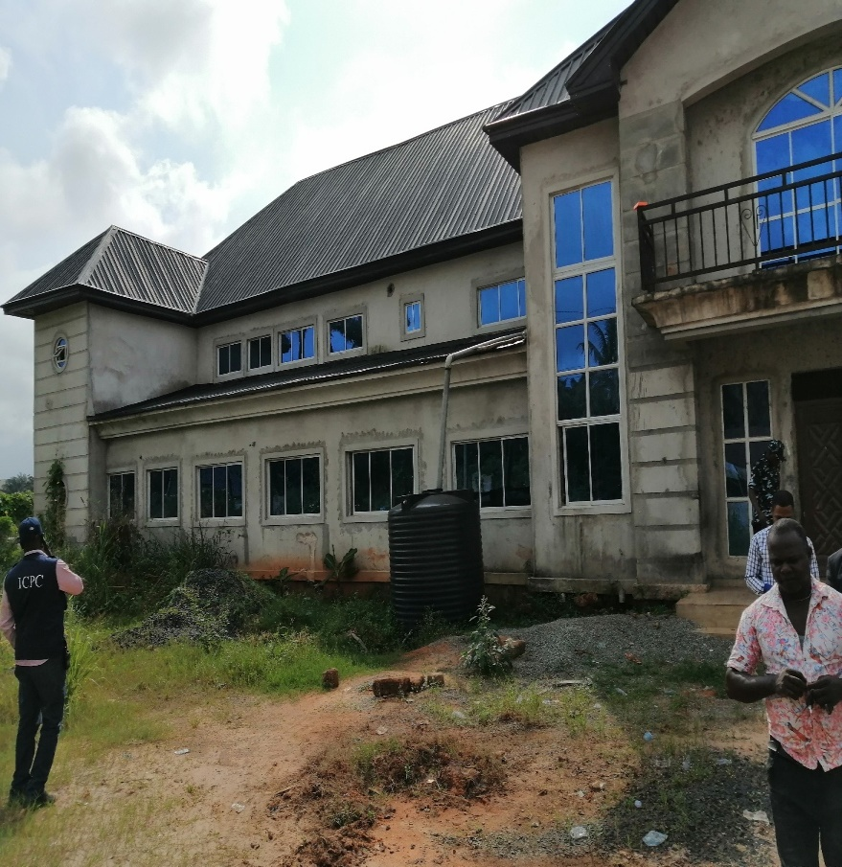
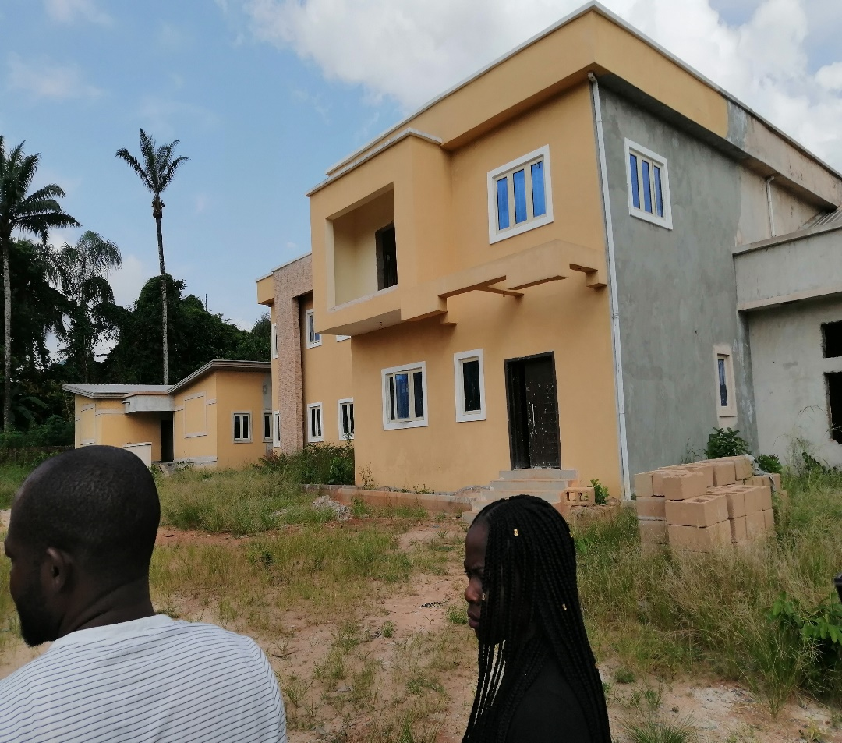
FINDINGS FROM PHASE 1 OF THE PROJECT
Projects sited on private property of sponsors

Slide 45
Other IMPORTANT FINDINGS
Duplications of some contracts of same description, same narrative, same amount, same location awarded by the same agency.
This we found done by the legislators in order to bring the total amount allocated to individual legislators within the approval threshold of the executing agency and to avoid ministerial tender processes.
An example: supply 8 nos. tractors to Bauchi Central Senatorial Zone supplied in 2016. A project of about N91, 935, 546 was split into 4 lots and awarded to 3 different contractors.

Slide 46
OTHER IMPORTANT FINDINGS CONTD…
Capacity Building and Empowerment projects: It entails training, supplies and distribution of varieties of such implements and tools as motorcycles, tricycles, sewing machines, grinding machines etc to constituents to empower them to own and operate their own businesses. It may also include cash grants in some cases.
These are convenient conduit for embezzling public funds by the sponsoring legislators and the executing agency as they are difficult to track and verify.

Slide 47
OTHER IMPORTANT FINDINGS
Most of the contracting companies belong directly or indirectly to the sponsoring legislator or the sponsoring legislator has a substantial interest in them one way or another.
In other cases, the contracts for the supplies of items were executed by personal staff of the legislator or their family members. These are clear cases of conflict of interests and abuse of office.
A few of the constituency projects were found sited on the private property of sponsoring legislators while some converted items supplied under the projects to private use. Examples are:

Slide 48
RECOVERIES CONTD…

Slide 49
RECOVERIES

Slide 50
OTHER IMPORTANT FINDINGS CONTD…
Constituency projects items which were meant to have been supplied to the Cottage Hospital, Ukan, Akwa Ibom State in March, 2018.
6 units of Massey Ferguson tractors were converted to personal use by deploying them to a private farm since 2016.
In Sokoto South-west projects were sited for the benefits of a private farm rather than that of the community. These projects were sited more than 5km away from the community but directly to a private farm.

Slide 51
OTHER IMPORTANT FINDINGS CONTD…
In Enugu North Senatorial District, CPTG found undistributed 51 units. Tricycles, 228 units. TVS Motorcycles, 203 units. Grinding Machines and 5 units, electric Transformers valued at over 400 million Naira. These items, some of which were acquired in 2017 were found in deteriorating conditions.
In Otuo Women and Children Hospital, Edo State, hundreds sets of top grade equipment have been supplied but the hospital building and all the equipment supplied were found in a state of disuse and deterioration.

Slide 52
OTHER IMPORTANT FINDINGS CONTD….
Another notable discovery is the “passing off” of projects by the sponsors as having been sponsored from their personal pockets and not paid for by the Federal Government, especially on Capacity Building and Empowerment Projects. Some sponsors even brand the items in their personal names.
Upper Niger River Basin Development Authority had the habit of asking the contractor for every project worth N100 million and above, to purchase and give a project vehicle even when that is not provided for in the Bill of Engineering Measurement and Evaluation (BEME).
We recovered 4 nos. Chico Cherry vehicles (4x4) valued at N40,000,000 purchased on the projects. The Kwaku/Kiyi Mini Water project is an example where QS report recommended the recovery of over N44 million.

Slide 53
ICPC ENFORCEMENT ACTIONS
Enforced distribution of empowerment items to beneficiaries;
Recovered embezzled monies;
Enforced the delivery of hospital equipment and ambulances to hospitals;
Facilitated commissioning processes of Otuo Women and Children Hospital;
Investigating a number of cases for prosecution;
Compelled the return of run-away contractors (34 + 200);
Recovered for government value of the projects hitherto abandoned.

Slide 54
IMPACT OF CEPTI ON THE PUBLIC
Public awareness created on issues around Constituency Projects;
Socio-economic impact to the community regarding the following projects:

Slide 55
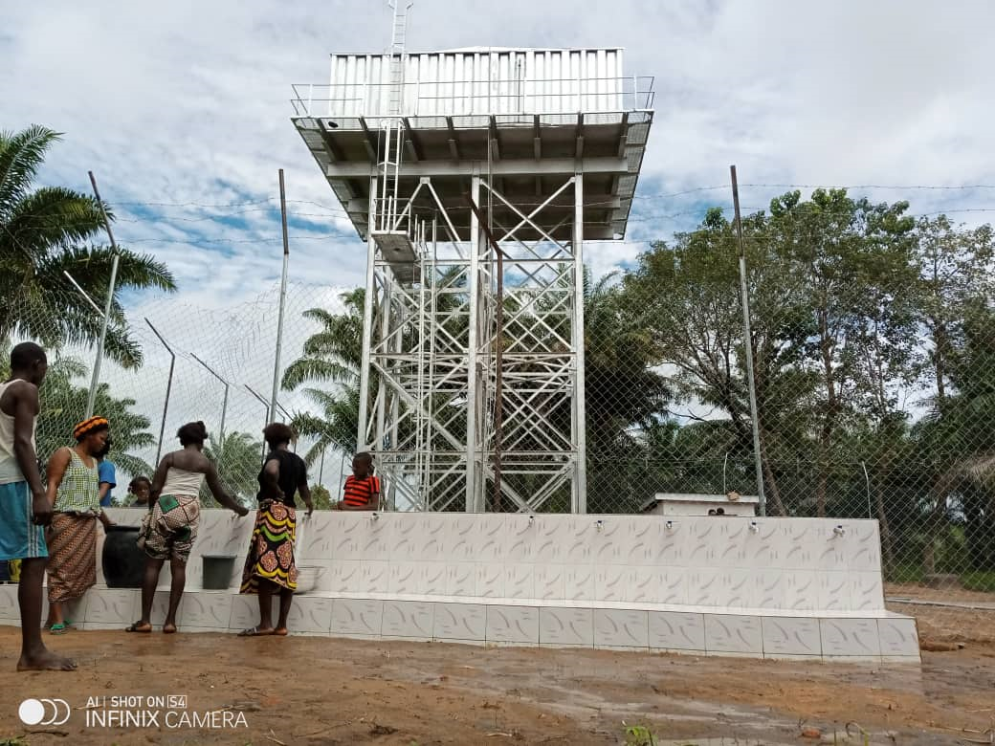
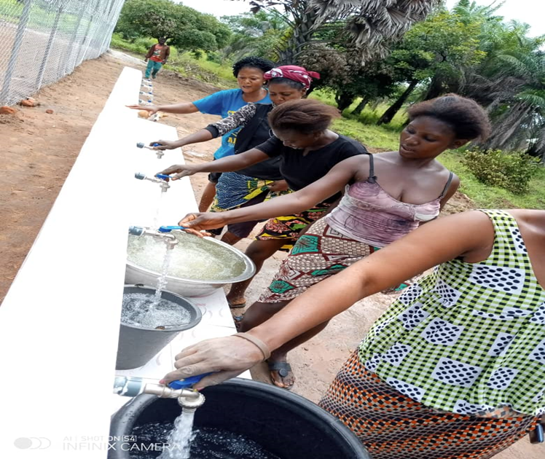
Water project in a community in Benue State

Slide 56
THE ROLE OF THE COMMUNITY
For sustainability, the local Communities must;
get involved in project conception through the sponsors;
take interest in projects sited in their communities;
protect the projects, and guard against vandalization, and,
Demand accountability from the project sponsors.

Slide 57
Expected Outcomes
Increased community and citizens’ awareness that constituency projects are publicly-funded and not donations by political benefactors.
Debunked assumption that constituency projects are avenues for providing financial largess to certain political office holders and their associates.
Increased community and citizens’ awareness of go-to portals and repositories of information on constituency projects, and reporting channels for infractions or feedback to ICPC.
Improved citizens’ access to details of constituency projects e.g. budget amount, contractors, budget releases, scope of project, etc.

Slide 58
Expected Outcomes Contd.
Engendered community ownership and participation in constituency projects conception, budgeting, monitoring, execution, etc.
Improved and organized constituency/executive projects’ tracking system.
Improved completion rate of constituency/Executive projects nationwide.
Removed ‘secrecy’ around constituency projects.
Improved mobilization of the grassroots for anti-corruption efforts.

Slide 59
ANTI- SEXUAL HARASSMENT IN EDUCATIONAL INSTITUTIONS POLICY
WHAT IS SEXUAL HARASSMENT?

Slide 61
ANTI- SEXUAL HARASSMENT IN EDUCATIONAL INSTITUTIONS POLICY
Sexual Harassment is usually defined as an unwelcome sexual advances or demand for sexual favours or any unwelcome conduct of a sexual nature targeted at someone in a work place, or any other professional or social situation or environment.
Apart from conferring undue advantage to oneself using office or position, which contravenes sections 19 of the ICPC Act 2000, sexual favours fall under the category of ‘’benefit’’ as defined in Section 2 of the ICPC law. Moreover, sexual harassment is a form of gender – based violence punishable under the Constitution of the Federal Republic of Nigeria.

Slide 62
ANTI- SEXUAL HARASSMENT IN EDUCATIONAL INSTITUTIONS POLICY
Sexual harassment, especially in educational institutions constitutes an attack on the very fabric of the society. It waters down the level and standards of education as the ability to pass exams would depend largely on how a female student for instance is ready to compromise her dignity.
Sexual harassment in educational institutions breeds monsters into the society in the name of trained and skilled persons. A student who ‘sells’ herself to clinch the Medical certificate would kill patients in the process of conducting surgery she never learned to do. The same goes for other sensitive professions such as engineering, even teaching because such a graduate teacher lacks the moral clout to impart values. The situation may be different if the student is raped.

Slide 63
ANTI- SEXUAL HARASSMENT IN EDUCATIONAL INSTITUTIONS POLICY
Sexual harassment in educational institutions is a conduct that is sexual in nature; it is unwelcome and it denies or limits the student’s ability to participate in or benefit from a school’s education programme or a staff ability to function properly in his assigned duties.
Sexual harassment in educational institutions makes schools unsafe. It hinders the promotion of better learning, teaching and psychological interactions among inhabitants of the school environment.

Slide 64
ANTI- SEXUAL HARASSMENT IN EDUCATIONAL INSTITUTIONS POLICY
Sexual harassment may be physical conduct of a sexual nature or verbal conduct of a sexual nature or non-verbal conduct of a sexual nature. It includes but not limited to pressure for a dating, romantic or intimate relationship, unwelcome touching, hugging, massaging, kissing, staring, leering, suggestive comments or jokes etc.

Slide 66
ANTI- SEXUAL HARASSMENT IN EDUCATIONAL INSTITUTIONS POLICY
OBJECTIVES OF THE POLICY:
To sensitize the institutions’ communities about the evils of sexual harassment;
To engender collective responsibility for eradicating sexual harassment;
To establish an institutional framework that encourages victims of sexual harassment to exercise their rights, maintain their dignity and resist its pressure;
To take appropriate action to eliminate sexual harassment in the institutions

Slide 67
ANTI- SEXUAL HARASSMENT IN EDUCATIONAL INSTITUTIONS POLICY
SCOPE OF THE POLICY:
The policy applies to all students, staff, visitors and those who take part one way or the other in the institutions’ activities or programmes at any location.

Slide 68
POLICY’S GUIDING PRINCIPLES
Compassion, support and assistance to the victim
Fair hearing and prompt attention
Confidentiality and Privacy

Slide 69
POLICY’S GUIDING PRINCIPLES
Protection from reprisals
Effective sanction regime
Safeguarding the Integrity of Educational Institutions in Nigeria

Slide 70
PROCEDURE FOR REPORTING SEXUAL HARASSMENT
Every Educational institution from Secondary schools to Colleges of Education, to Polytechnics up to the Universities are expected to formulate their Anti-sexual Harassment Policy to reflect their uniqueness;
Such policies must be widely publicized detailing how victims can take advantage of the redress mechanisms contained in the Policy;
The Educational institutions are encouraged to go further by forming Independent Anti-sexual Harassment Committees which should include staff (academic and non-academic), members of the host communities, parents teachers associations and students.
Victims and or witnesses (where available) are encouraged to report cases of sexual harassment to constituted Independent Anti-Sexual Harassment Committees of their various institutions or relevant designated officials and or the ICPC through formal report or by calling the Commission via its 12-digit smart tall – free line: 080022554272.

Slide 71
PROCEDURE FOR REPORTING SEXUAL HARASSMENT
Format of A Report:
Report can be made verbally or in writing;
Report should contain name, address, contact numbers and any other relevant details of the complainant, but these details must be kept strictly confidential; to be used only for the purpose of investigation and possible prosecution if prima-facie case is established;
Report should contain the name, address and contact details of the person (s) against whom the complaint is made;
Report should contain summary of the allegation (s) which should include nature of harassment, date, time and place where the alleged harassment took place.

Slide 72
INVESTIGATION, TIME FRAME AND SANCTIONS
1. Report of sexual harassment must be thoroughly investigated to avoid false allegations;
2. Investigation must be conducted and completed within 45 working days.
3. Where the accused refuses to cooperate with the investigation process, investigation shall continue.
4. Where it is determined that a case is proved, appropriate sanctions must be served.
5. Such sanctions, which largely depend on the gravity of the offence committed may include but not limited to:

Slide 73
RECOMMENDED SANCTIONS
1. Reprimand
2. Query
3. Warning
4. Probation and counselling
5. Campus access restriction (in the case of visitors)
6. Loss of privileges
7. Demotion
8. Termination or Dismissal
9. Expulsion (in the case of students)
10. Termination of contract (in the case of contractors)
11. Witholding of certificates e.g Degrees, Diplomas etc
12. Prosecution in a competent Court of jurisdiction.

Slide 74
THE ROLE OF ICPC IN CURBING SEXUAL HARASSMENT IN EDUCATIONAL INSTITUTIONS
The involvement of ICPC in the fight against sexual harassment in workplace including educational institutions is not accidental.
By virtue of its statutory mandate contained in Section 6 ( a – f) of the Corrupt Practices and Other Related Offences Act 2000, ICPC is empowered to take any lawful and legitimate measure to curb corrupt practices and sexual harassment in workplace is a form of corruption because, as stated earlier, the assailant confers undue advantage to himself by virtue of his position - an offence punishable under Section 19 of the ICPC Act 2000.

Slide 75
THE ROLE OF ICPC IN CURBING SEXUAL HARASSMENT IN EDUCATIONAL INSTITUTIONS
It was on that basis that the Commission was able to successfully prosecute and secure a conviction against a University Professor and is currently prosecuting another on the account of sexual harassment.
Secondly, by virtue of Section 70 and 71 of the ICPC Act, which empowers the ICPC to introduce and adopt any measure or policy that could help in the fight against corruption, the Commission has introduced a number of measures aimed at resuscitating our time-tested and time-honoured values of integrity, honesty, human dignity, patriotism, voice and participation in order to fast – tract the fight against corruption. Therefore the Commission is determine to fight any conduct that smack of lack of integrity, including sexual harassment.

Slide 76
KEY STAKEHOLDERS IN THE FORMULATION OF MODEL POLICY AGAINST SEXUAL HARASSMENT IN EDUCATIONAL INSTITUTIONS
ICPC
Educational Institutions across the country
Civil Society Groups, notably the Gender Mobile Initiative
Federal and States Ministries of Education
Universal Basic Education Commission
States Universal Basic Education Boards
National Commission for Colleges of Education
National Board for Technical Education
National and States Parents Teachers Associations
The Media
Foreign Technical Partners, notably the Ford Foundation
National Universities Commission
States Secondary Education Boards etc

Slide 77
CURRENT STATUS OF THE POLICY
It is instructive to note that the Sexual Harassment in Tertiary Institutions Bill has been passed by the National Assembly and is awaiting assent. This underscores the importance attached to the issue of sexual harassment.
This Model Policy on Anti-sexual Harassment in Educational institutions in Nigeria is not a duplication of efforts but a way of strengthening the Bill passed by the National Assembly. The Policy which is still at its infancy has been transmitted to the Federal Ministry of Education for input.

Slide 78
CONCLUSION
We have so far seen and discussed only three major strategies introduced and being implemented by ICPC. Time would not allow us to discuss illicit financial flows but if I were a Managing Editor, I would set up a desk specially on illicit financial flows and attach a reporter to the secretariat of illicit financial flows under the watch of Professor Bolaji Owasanoye, SAN, OFR, because a lot is being done to curb illicit financial flows which should attract quantity and quality reportage by the media.

Slide 79
So far we have seen that most of ICPC’s activities are newsworthy. The Commission conducts its activities in a transparent manner. That is ICPC was considered the best compliant agency to the Freedom of Information Act 2011 in 20219.
In conclusion, it is my ardent prayer that the media would exploit all the opportunities offered by ICPC to play their statutory roles as fourth estate of the realm by engaging in investigative journalism and reporting anti-corruption activities with the fairness, objectivity and balance that they deserve.

Slide 80
THANK YOU AND GOD BLESS!
Notes:
Animated balloon floats into distance
(Advanced)
To reproduce the balloon on this slide, do the following:
On the Home tab, in the Slides group, click Layout, and then click Blank.
On the Home tab, in the Drawing group, click Shapes, under Basic Shapes, click Teardrop (second row, fourth from the left). On the slide, drag to draw the teardrop.
Under Drawing Tools, on the Format tab, in the Size group, click the Size and Position dialog box launcher, and then in the Format Shape dialog box, click Size in the left pane. In the Size pane, under Size and rotate, do the following:
In the Height box, enter 1.66”.
In the Width box, enter 1.7”.
In the Rotation box, enter 133⁰.
Also in In the Format Shape dialog box click Fill in the left pane, select Gradient fill in the Fill pane, and then do the following:
In the Type list, select Linear.
In the Angle box, enter 90.
Under Gradient stops, click Add gradient stops or Remove gradient stops until three stops appear in the slider.
Also under Gradient stops, customize the gradient stops as follows:
Select the first stop in the slider, and then do the following:
In the Position box, enter 13%.
Click the button next to Color, and then under Theme Colors click Red, Accent 2, Darker 25% (fifth row, sixth option from the left).
In the Transparency box, enter 0%.
Select the next stop in the slider, and then do the following:
In the Position box, enter 66%.
Click the button next to Color, and then under Theme Colors click Red, Accent 2, Lighter 40% (fourth row, sixth option from the left).
In the Transparency box, enter 0%.
Select the last stop in the slider, and then do the following:
In the Position box, enter 100%.
Click the button next to Color, and then under Theme Colors click White, Background 1 (first row, first option from the left).
In the Transparency box, enter 0%.
Also in the Format Shape dialog box in the left pane, click Line Color, and in the Line Color pane, select No line.
On the Home tab, in the Drawing group, click Shapes, and then under Basic Shapes, click Isosceles Triangle (third option from the left). On the slide, drag to draw the isosceles triangle.
Select the isosceles triangle. Under Drawing Tools, on the Format tab, in the Size group, click the Size and Position dialog box launcher. In the Format Shape dialog box, click Size in the left pane. in the Size pane, under Size and rotate, do the following:
In the Height box, enter 0.16”.
In the Width box, enter 0.11”.
In the Rotation box, enter 8⁰.
Also in the Format Shape dialog box, in the left pane, click Fill. In the Fill pane, click Solid Fill. Click the button next to Color, and then under Theme Colors click Red, Accent 2, Darker 25% (fifth row, sixth option from the left).
Also in the Format Shape dialog box in the left pane, click Line Color, and then in the Line Color pane select No line.
Position the isosceles triangle on the slide so that the sharp angle touches the point of the teardrop.
On the Home tab, in the Drawing group, click Shapes, and under Lines click Curve (tenth option from the right). On the slide, draw a curve (for, example, one that has four points). Press ESC to end the curve.
Select the curvy line. On the Home tab, in the Drawing group, click the arrow next to Shape Outline, and then under Theme Colors, click White, Background 1, Darker 15% (third row, first option from the left).
On the Home, in the Drawing group, click Shape Outline, point to Weight, and then click 1 pt.
Position the curve on your slide so that one end is touching the bottom edge of the isosceles triangle.
On the Home tab, in the Drawing group, click Shapes, and under Basic Shapes, select Oval (second option from the left). On the slide, drag to draw an oval.
Select the oval. Under Drawing Tools, on the Format tab, in the Size group do the following:
In the Shape Height box, enter 1.2”.
In the Shape Width box, enter 1.2”.
Under Drawing Tools, on the Format tab, in the Shape Styles group, click the arrow next to Shape Fill, point to Gradient, and then click More Gradients.
In the Format Shape dialog box, in the left pane click Fill. In the Fill pane, select Gradient fill.
In the Type list, select Radial.
Click the button next to Direction, and then click From Center (third option from the left).
Under Gradient stops, click Add gradient stops or Remove gradient stops until three stops appear in the slider.
Also under Gradient stops, customize the gradient stops as follows:
Select the first stop in the slider, and then do the following:
In the Position box, enter 0%.
Click the button next to Color, and then under Theme Colors click White, Background 1 (first row, first option from the left).
In the Transparency box, enter 0%.
Select the first stop in the slider, and then do the following:
In the Position box, enter 50%.
Click the button next to Color, and then under Theme Colors click White, Background 1 (first row, first option from the left).
In the Transparency box, enter 81%.
Select the first stop in the slider, and then do the following:
In the Position box, enter 71%.
Click the button next to Color, and then under Theme Colors click White, Background 1 (first row, first option from the left).
In the Transparency box, enter 100%.
Also in the Format Shape dialog box in the left pane, click Line Color, and then in the Line Color pane click No line.
Position the oval at the top, left edge of the teardrop to create a lighting effect.
Press and hold CTRL, and then select all four objects. On the Home tab, in the Drawing group, click Arrange, and then under Group Objects click Group.
To reproduce the animation effects on this slide, do the following:
On the slide, select the balloon and drag it off the bottom left corner of the slide.
On the Animations tab, in the Advanced Animation group, click Add Animation, and then click More Motion Paths. In the Motion Path dialog box, under Lines & Curves, click Diagonal Up Right, and then click OK.
On the slide, select the motion path and then drag the end point (red triangle) across the slide and off the top right corner.
On the Animations tab, in the Timing group, in the Start list, select With Previous.
On the Animations tab, in the Timing group, in the Duration box, enter 32.
On the Animations tab, in the Advanced Animation group, click Add Animation, and then under Emphasis click Grow/Shrink.
On the Animations tab, in the Timing group, in the Start list, select With Previous.
On the Animations tab, in the Timing group, in the Duration box, enter 32.
On the Animations tab, in the Animation group, click Effect Options, and then click the Show Additional Effect Options dialog box launcher. In the Grow/Shrink dialog box, under Settings, click the arrow next to the Size box and in the Custom box, enter 2%.
To reproduce the background on this slide, do one of the following:
Note: You can save the background of this slide template as a picture and use it in your own slides. To use the same background as this slide, do the following:
Right-click the sky background on the original template, and then click Save Background.
Save the file as a JPEG (.jpg) file format.
On the Design tab, in the Background group, click Background Styles, and then click Format Background. In the Format Background dialog box, click Fill in the left pane, select Picture fill in the Fill pane, and then under Insert from click File.
In the Insert Picture dialog box, select a picture, and then click Insert.

Slide 81
Contact ICPC Via:
E-mail: info@icpc.gov.ng
Website: www.icpc.gov.ng
Toll-free lines (MTN and GLO): 0800-CALL-ICPC (0800-2255-4272)
08031230280, 08031230281, 08031230282,
07056990190, 07056990191,
@ICPC Nigeria

