Slide 1
OVERVIEW OF ICPC PERFORMANCE: 2019 – 2023
AT A 2-DAY CAPACITY BUILDING TRAINING FOR THE MEDIA PRACTITIONERS
BY JUDE OKOYE (FCA)
DEPUTY DIRECTOR (PRS)
ICPC HQ, ABUJA.
19TH JUNE 2023

Slide 2
OUTLINE
Background
Our Strategy
The Result Framework
2019 – 2023 Strategic Plan Monitoring Matrix
Strategy Implementation
Overview of ICPC Achievements from 2019 to 2023
Challenges
Conclusion

Slide 3
BACKGROUND
A Strategic Workshop held in November 2018
Development of a Draft Strategic Plan: 2019 - 2023
Presentation of Draft Plan for Board’s Review and Adoption
Upward Review of Set-Targets by 20%
Adoption of the Plan by the Board
Development of ICPC Dashboard & Plan Implementation

Slide 4
OUR STRATEGY
OUR STRATEGY
67 Strategic Activities
24 Key Performance Indicators

Slide 5
RESULT FRAMEWORK
VISION
A Nigeria free of all forms of corruption and corrupt practices
MISSION
To rid Nigeria of corruption through lawful enforcement and preventive measures
Impact Indicator
0.01: Improved public perception of/confidence in ICPC
0.02: Improved rating of Nigeria on TI’s annual CPI
Key Objective 1: More Effective Reportage, investigation and Prosecution of Corruption Cases
Key Objective 2: Reduction of System-Induced Corrupt Practices and improved mobilization of the Citizenry to fight corruption
Key Objective 3
Increased Managerial Effectiveness of ICPC
KPI 1.01: Value of assets forfeited /recovered/restrained
KPI 1.02: No. of investigated cases concluded
KPI 1.03: No. of Cases filed for prosecution
KPI 1.04: No. of convictions secured
KPI 1.05: No. of Projects tracked under the CEPT Initiative
KPI 2.01: No. of MDAs that are assessed for compliance under Systems Studies and CRAs.
KPI: 3.01: Annual Staff Scorecard on Management Performance
KPI: 3.02: Annual Unqualified Audit of ICPC by External Auditors
Outcome 2.1
Improved Mechanisms for Corruption Prevention in the Public sector
Outcome 2.2
Increased Public Empowerment against Corruption
Outcome 1.1
Increase Reporting of Corruption Cases by Citizens
Outcome 1.2
Improved Capacity to Investigate and Prosecute Cases
KPI 2.11: No. of MDAs that make progress in compliance with Systems Studies and CRAs recommendations.
KPI 2.12: No. of corruption monitoring activities undertaken by ICPC
KPI 2.13: No. of MDAs assessed with Ethics and Compliance Scorecard
Outcome 3.1
Improved Management Effectiveness, Style and Culture
KPI 2.21: No of anti-corruption activities undertaken by ICPC-supported CSO platforms
KPI 2.22: No. of Hits and feedback on ICPC website and other communication platforms.
KPI 2.23: No. of sensitization sessions conducted by ICPC
KPI 2.24: No. of anti-corruption clubs and Vanguards formed
KPI 2.25: No. of Individuals trained by ACAN
KPI 1.11: No. of new petitions received through ICPC established channels
KPI 1.12: No. of petitions meeting case tracking standards of acknowledgement, investigation and completion.
KPI 1.21: Duration between receipt of Petitions and conclusion of investigations
KPI 1.22: Duration between conclusion of investigations and Filing of cases
KPI 1.23: No. of Staff trained in investigation, prosecution and case management
KPI 1.24: No. of non-petition Intelligence-led investigations conducted
KPI 3.11: No of Partnership actions/initiatives taken in collaboration with other anti-corruption agencies
KPI 3.12: No. of Quarterly report responded to and considered by the Chairman/Board.
5
5

Slide 6
2019 - 2023 STRATEGIC PLAN MONITORING MATRIX
S/NO. | KPI No./Measure | 2019 | 2020 | 2021 | 2022 | 2023 | Set-Target over 5 Years 2019 - 2023
1 | KPI 1.01: Naira value of assets forfeited /recovered/restrained | N15b | N18b | N22b | N26b | N31b | N112b
2 | KPI 1.02: No. of investigated cases concluded | 960 | 1,152 | 1,382 | 1,659 | 1,991 | 7,144
3 | KPI 1.03: No. of cases filed in court for prosecution | 80 | 90 | 100 | 110 | 120 | 500
4 | KPI 1.04: No. of convictions secured | 30 | 35 | 40 | 45 | 50 | 200
5 | KPI 1.05: No. of Projects tracked under the CEPT Initiative | 400 | 480 | 576 | 691 | 829 | 2,976 Projects
6 | KPI 1.11: No of new petitions received through ICPC established channels | 2,040 | 2,448 | 2,938 | 3,525 | 4,230 | 15,181
7 | KPI 1.12: No. of petitions met case tracking standards of acknowledgement, investigation and completion | Set Mechanism | 70% | 80% | 90% | 100% | Aggregate of 340%
8 | KPI 1.21: Duration between receipt of petitions and conclusion of investigations | Set Mechanism | 60 days | 60 days | 60 days | 60 days | 60 days

Slide 7
2019 - 2023 STRATEGIC PLAN MONITORING MATRIX …/2
S/NO. | KPI No./Measure | 2019 | 2020 | 2021 | 2022 | 2023 | Set-Target over 5 Years 2019 – 2023
9 | KPI 1.22: Duration between conclusion of investigations and filing of cases | Set Mechanism | 30 days | 30 days | 30 days | 30 days | 30 days
10 | KPI 1.23: No. of staff trained in investigation, prosecution and case management | 300 | 300 | 300 | 300 | 300 | 1,500 Trainings for Staff
11 | KPI 1.24: No of non-petition Intelligence-led investigation | 420 | 504 | 605 | 726 | 871 | 3,126 Cases
12 | KPI 2.01: Number of MDAs that are assessed for compliance under system studies and corruption risk assessments (CRAs). | 20 | 24 | 29 | 35 | 41 | 149 MDAs
13 | KPI 2.11: Number of MDAs that make progress in compliance with the System Studies and CRAs recommendations. | 12 | 14 | 17 | 21 | 25 | 89 MDAs
14 | KPI 2.14: Number of corruption monitoring activities undertaken by ICPC | 60 | 72 | 86 | 104 | 124 | 446 Monitoring Activities in MDAs
15 | KPI 2.15: Number of MDAs assessed with Ethics and Compliance Scorecard | 60 | 72 | 86 | 104 | 124 | 446 MDAs
16 | KPI 2.21: No. of anti-corruption activities undertaken by ICPC- supported CSO platforms | 72 | 86 | 104 | 125 | 149 | 536

Slide 8
2019 - 2023 STRATEGIC PLAN MONITORING MATRIX …/3
S/NO. | KPI No./Measure | 2019 | 2020 | 2021 | 2022 | 2023 | Set-Target over 5 Years 2019 - 2023
17 | KPI 2.22: No of Hits and Feedbacks on ICPC websites and other communication platforms | 1,000,000 | 1,000,000 | 1,000,000 | 1,000,000 | 1,000,000 | 5,000,000 hits
18 | KPI 2.23: No of sensitization sessions conducted by ICPC | 660 | 726 | 799 | 878 | 966 | 4,029
19 | KPI 2.24: No of anti-corruption clubs and vanguards formed | 220 | 242 | 266 | 293 | 322 | 1,343
20 | KPI 2.25: No. of individuals trained by ACAN | 3,500 | 4,200 | 5,040 | 6,048 | 7,258 | 26,046
21 | KPI 3.01: Annual Staff Scorecard on management Performance | 50% | 60% | 70% | 80% | 90% | Aggregate of 350%
22 | KPI 3.02: Annual Unqualified Audit of ICPC by External Auditors | 70% | 75% | 80% | 85% | 90% | Aggregate of 400%
23 | KPI 3.11: No of partnership actions/initiatives with other ACAs | 21 | 22 | 23 | 24 | 25 | 115
24 | KPI 3.12: No. of Quarterly Reports responded to and considered by the Chairman/Board | 2 | 4 | 4 | 4 | 4 | 18 Quarterly Reports responded to

Slide 9
OVERVIEW OF ICPC ACHIEVEMENTS FROM 2019 TO MARCH 2023
The Commission recorded a remarkable average performance of 134.99% within the past four years and three months.
The Commission made impressive performance in some KPIs like assets recoveries, staff training by taking advantage of webinar platforms, non-petition Intelligence-led investigation, MDAs assessed with Ethics and Compliance Scorecard, corruption monitoring activities, Anti-Corruption activities undertaken by ICPC- supported CSO platforms, Hits and Feedbacks on ICPC websites and other communication platforms. Others include cases filed in court, Annual Auditing of ICPC, Annual Staff Scorecard on Management Performance, etc.
Some KPIs did not perform optimally relative to the targets set. These include number of convictions, petitions received, number of system studies and CRAs conducted, system reviews conducted, anti-corruption clubs and vanguards formed, individuals trained by ACAN, etc.

Slide 10
OVERVIEW OF ICPC ACHIEVEMENTS FROM 2019 TO MARCH 2023 …/2
The review of status of the 67 strategic activities indicates slight progress from the last evaluation report as contained below:
47 out of the 67 Strategic Activities have been so far executed; thus, representing 70.1% completion.
13 Strategic Activities are still work-in-progress; indicating that 19.4% of the total have commenced, and yet to be completed.
Only 7 activities are still outstanding. This represents 10.5% of the total.
The alignment of ICPC Strategy with the National Anti-Corruption Strategy (2017 – 2021) is very commendable. The ICPC Strategic Plan was duly aligned with the NACS at the point of its development. Out of the 67 strategic Activities of the ICPC, 31 were drawn from the NACS, of which the Commission has fully executed 24 activities; 3 are on-going while 4 are outstanding.

Slide 11
OVERVIEW OF ICPC ACHIEVEMENTS FROM 2019 TO 2022 …/3
The Organizational assessment of ICPC for Enhanced Performance by DAI also put the Commission in a good spotlight given the efforts of the Commission in rigorously implementing the plan.
Also, the Conduct of System Study of ICPC by external persons has helped to improve ICPC systems and processes.
Even though the assessment report on the Country Mission Project by the Commonwealth Africa Anti-Corruption Centre (CAACC) and African Development Bank(AfDB) spotted out areas of improvement in our next strategic plan, it also commended Commission’s achievements in the plan and its efforts in driving the implementation of its strategic plan.
The Constituency and Executive Project Tracking Initiative (CEPTI) initiated by the Commission in 2019 has helped in ensuring good governance, accountability and transparency in the implementation of Zonal Intervention Projects (ZIP) by the National Assembly and executive arm of federal government. So far, a total number of 3,422 projects have been tracked with records of successes.

Slide 12
OVERVIEW OF ICPC ACHIEVEMENTS FROM 2019 TO MARCH 2023 …/4
The current Board increased the number of state offices across the country from 15 to 21 by opening six new offices one in each of the six geo-political zones.
The activities of the Commission during the ICPC @ 20 are very remarkable achievements during the period under review. They include:
Africa Regional Webinar on Combating Corruption and Illicit Financial Flows, New Measures and Strategies.
Youth Involvement – 2 Competitions aimed at provoking youth creativity and support the fight against corruption with N20m prize money donated by MacArthur Foundation for National Music Competition and Essay Competition
ICPC @ 20 commemorative book.
Retreat with National Assembly Committee on Anti-Corruption.
Engagement with Judiciary on Role in the Fight Against Corruption.

Slide 13
OVERVIEW OF ICPC ACHIEVEMENTS FROM 2019 TO MARCH 2023 …/5
The Hosting of Annual Summit on Diminishing Corruption in Public Sector which has consistently had the presence of immediate past President, Muhammadu Buhari in the last four year remains a landmark event for ICPC.
The Public Service Integrity Award Series by the erstwhile President of the Federal Republic of Nigeria.
The adoption of National Ethics and Integrity Policy and its launching by erstwhile President is another great achievement of the Commission.
ACAN coordinated ICPC’s Policy dialogues which brought diverse stakeholders together to discuss topical issues and this has resulted in production of policy briefs in Vote Buying; Utilization of Security Vote; Corruption and Cost of Governance; Entrenching Transparency in Public Service Recruitment and Corruption and Insecurity.
The efforts of the Commission in championing the fight against Illicit Financial Flows in Nigeria and Africa by extension is a well deserved one. 2 Conferences (regional and international conferences) hosted on Illicit Financial Flows in 2020.

Slide 14
OVERVIEW OF ICPC ACHIEVEMENTS FROM 2019 TO MARCH 2023 …/6
The Initiative to eradicate Sexual Harassment in the Education has been gaining momentum.
Improved infrastructural development in the following areas:
The development and operationalization of the Case Management Software (EDMS).
Upgrade of Auditorium with state-of-the-Art equipment.
Upgrade of Interview Rooms and Construction of New Ones and Detention Facility.
Acquisition of a Surveillance Vehicle for specialized and more sophisticated investigative activities.
Utilization and Optimization of Forensic Investigation Infrastructure: The Acquisition of Document and Handwriting Analysis Equipment and Polygraph Machines have proven useful in conducting background checks and evaluating the credibility of respondents. The Commission has collaborated with the Head of Civil Service of the Federation to profile 71 Permanent Secretary Nominees, 23 Accountant General of the Federation Nominees, 5 Auditor General for the Federation Nominees, etc. through polygraph tests.
Introduction of Biometrics and Digitalization of Attendance Register.

Slide 15
OVERVIEW OF ICPC ACHIEVEMENTS FROM 2019 TO MARCH 2023 …/7
The Restructuring and Organizational Reform of the Commission carried out by the Board is another achievement which tend to eliminate functional overlaps and unnecessary duplication of functions among the departments. Particularly, the supervision of all investigative divisions under a single head has contributed to a better coordination of investigative activities. This was achieved through the engagement of a public service organizational management consultant in collaboration with OHCSF in 2020 reducing departments to 10 covering core areas and units to 6.
The Constitution of Case Mgt. Committee has helped to speed up review of petitions, streamline cases being handled by Commission, amongst others. The repositioning of Chairman’s Special Unit (CSU) as a designated unit for offering legal opinion on petitions (and later upgraded to a department) has facilitated review of petitions greatly.

Slide 16
OVERVIEW OF ICPC ACHIEVEMENTS FROM 2019 TO MARCH 2023 …/8
The Commission has made efforts to up its enforcement activities through the formulation of Asset Management and Disposal Policy and implementation of the Asset Management Guidelines. This was possible with the constitution of the Assets Disposal Committee with representatives of NLC, NUJ, CSO and BPP as observers to enhance transparency and accountability of the process.
Regular meeting of the Directors with members of the board and regular board meetings to deliberate on critical matters concerning the Commission are very commendable.
The setting up of committees to review some key policy documents and the subsequent printing and sensitization of staff on the policy documents, guidelines and manuals have helped to enhance productivity and job performance.
Development and operationalization of Performance Dashboard as a mechanism for performance review has helped to sustain the implementation process.

Slide 17
OVERVIEW OF ICPC ACHIEVEMENTS FROM 2019 TO MARCH 2023 …/9
Another landmark is the collaboration with foreign partners to draft the Common African Position on Asset Recovery (CAPAR) that was adopted in February 2020 by African Union.
Our collaboration and partnership with other agencies and donor partners have helped to bring more positive outcomes to the Commission’s activities and performance. This includes collaboration with agencies like NFIU, FIRS, INEC, FIRS, JAMB, NUC, NBTE, and other ACAs and LEAs.

Slide 18
Strategy implementation

Slide 19
Strategy implementation …/2

Slide 20
Strategy implementation …/3

Slide 21
Strategy implementation …/4
KPI 1.01: Naira value of assets forfeited/recovered/seized/restrained
KPI 1.03: No. of cases filed in court for prosecution
KPI 1.02: No. of investigated cases concluded
KPI 1.04: No. of convictions secured

Slide 22
Strategy implementation …/5
KPI 1.05: No. of Projects tracked under CEPT Initiative
KPI 1.23: No. of staff trained in investigation, prosecution and case management
KPI 1.11: No of new petitions received through ICPC established channels
KPI 1.24: No of non-petition Intelligence-led investigation

Slide 23
Strategy implementation …/6
KPI 2.01: Number of MDAs that are assessed for compliance under system studies and corruption risk assessments (CRAs).
KPI 2.12: Number of corruption monitoring activities undertaken by ICPC
KPI 2.11: Number of MDAs that make progress in compliance with the System Studies and CRAs recommendations.
KPI 2.13: Number of MDAs assessed with Ethics and Compliance Scorecard

Slide 24
Strategy implementation …/7
KPI 2.21: No. of anti-corruption activities undertaken by ICPC- supported CSO platforms
KPI 2.23: No of sensitization sessions conducted by ICPC
KPI 2.22: No of Hits and Feedbacks on ICPC websites and other communication platforms
KPI 2.24: No of anti-corruption clubs and vanguards formed

Slide 25
Strategy implementation …/8
KPI 2.25: No. of individuals trained by ACAN
KPI 3.02: Annual Auditing of ICPC
KPI 3.01: Annual Staff Scorecard on management Performance
KPI 3.11: No of partnership actions/initiatives with other ACAs and donor partners

Slide 26
Strategy implementation …/9
KPI 3.12: No. of Quarterly Reports responded to and considered by the Chairman/Board

Slide 27
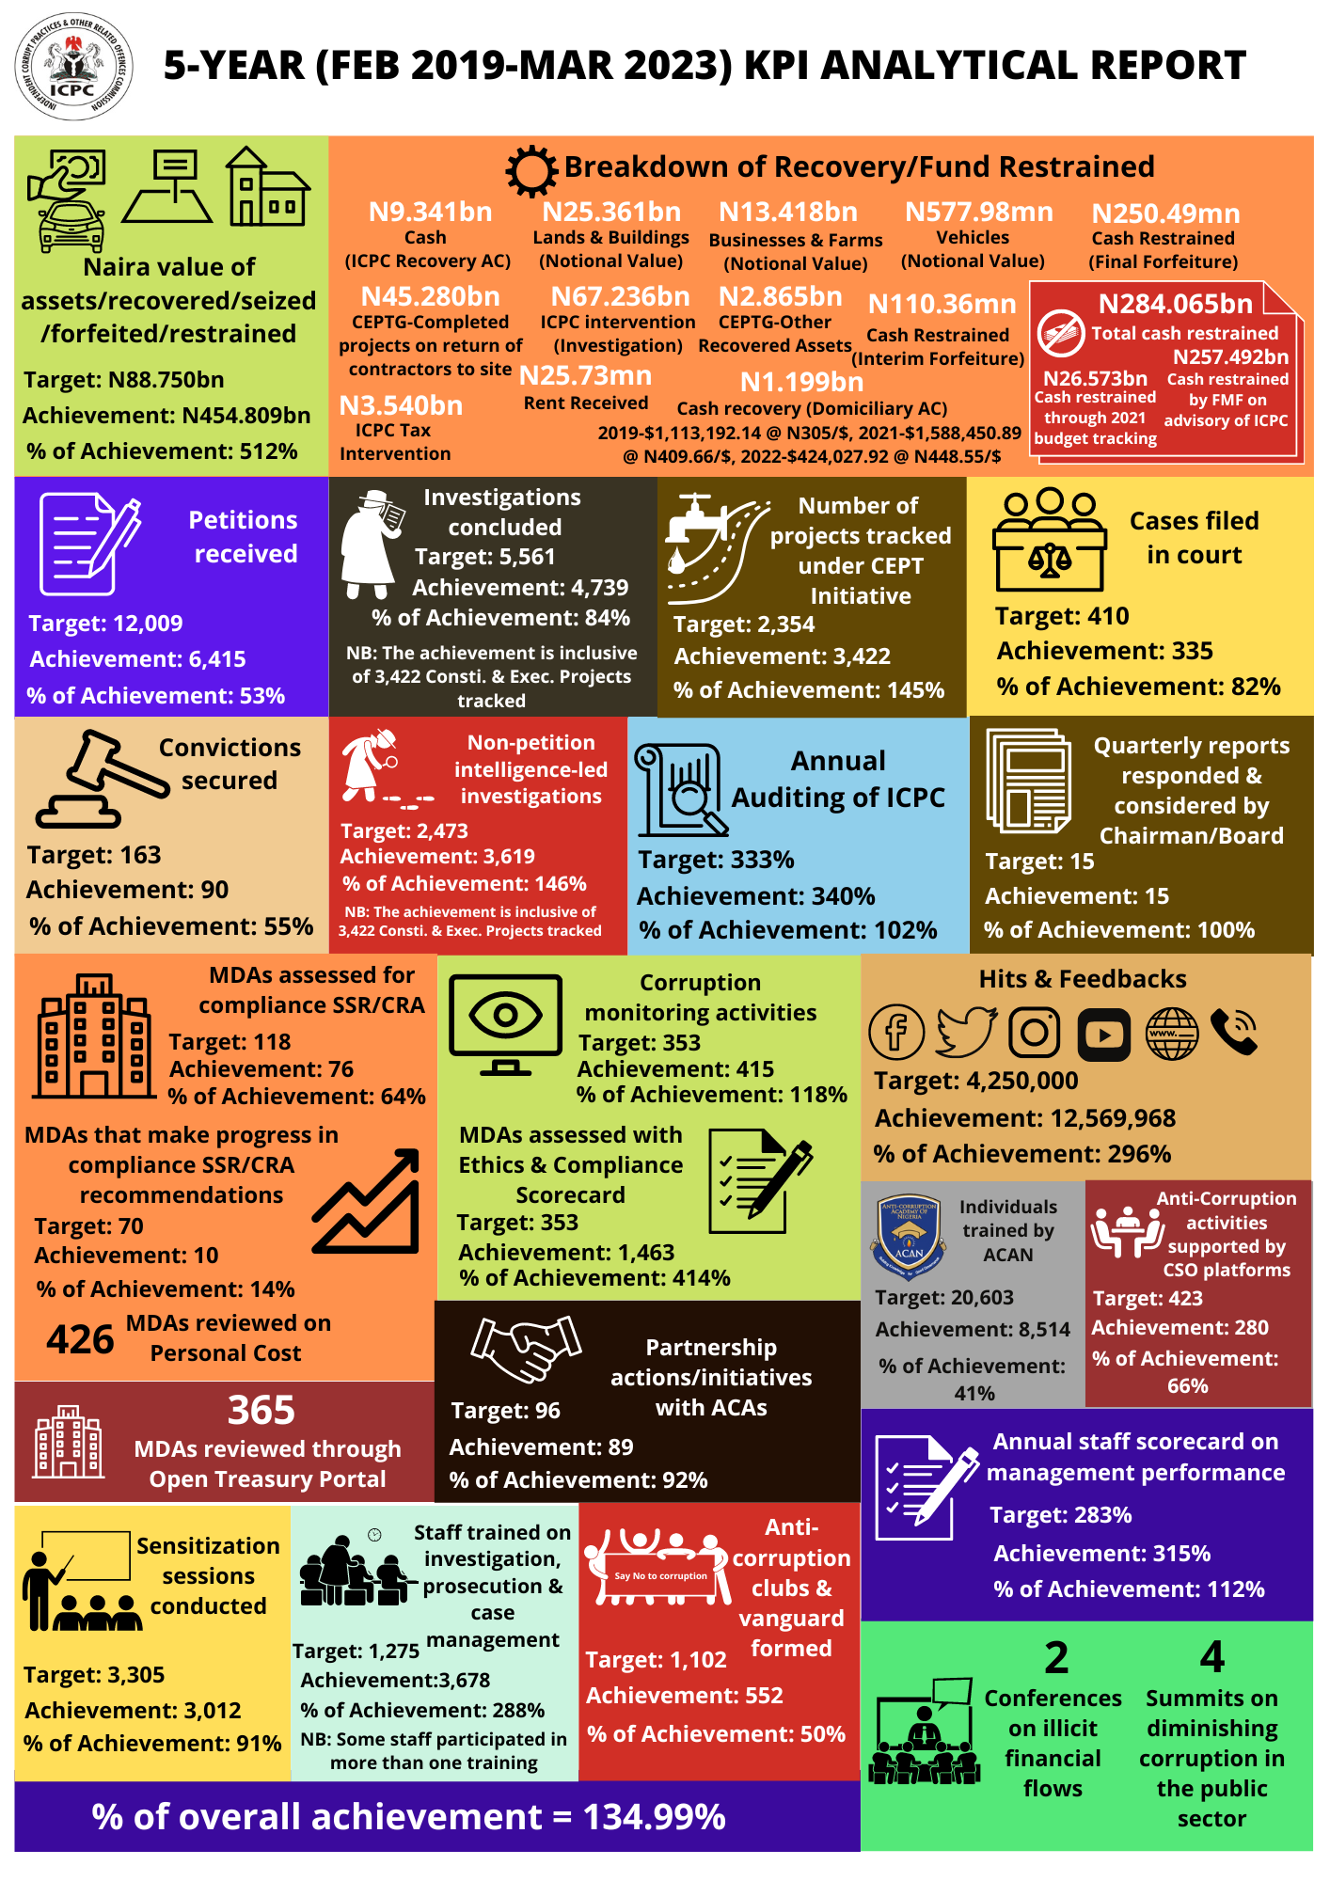

Slide 28
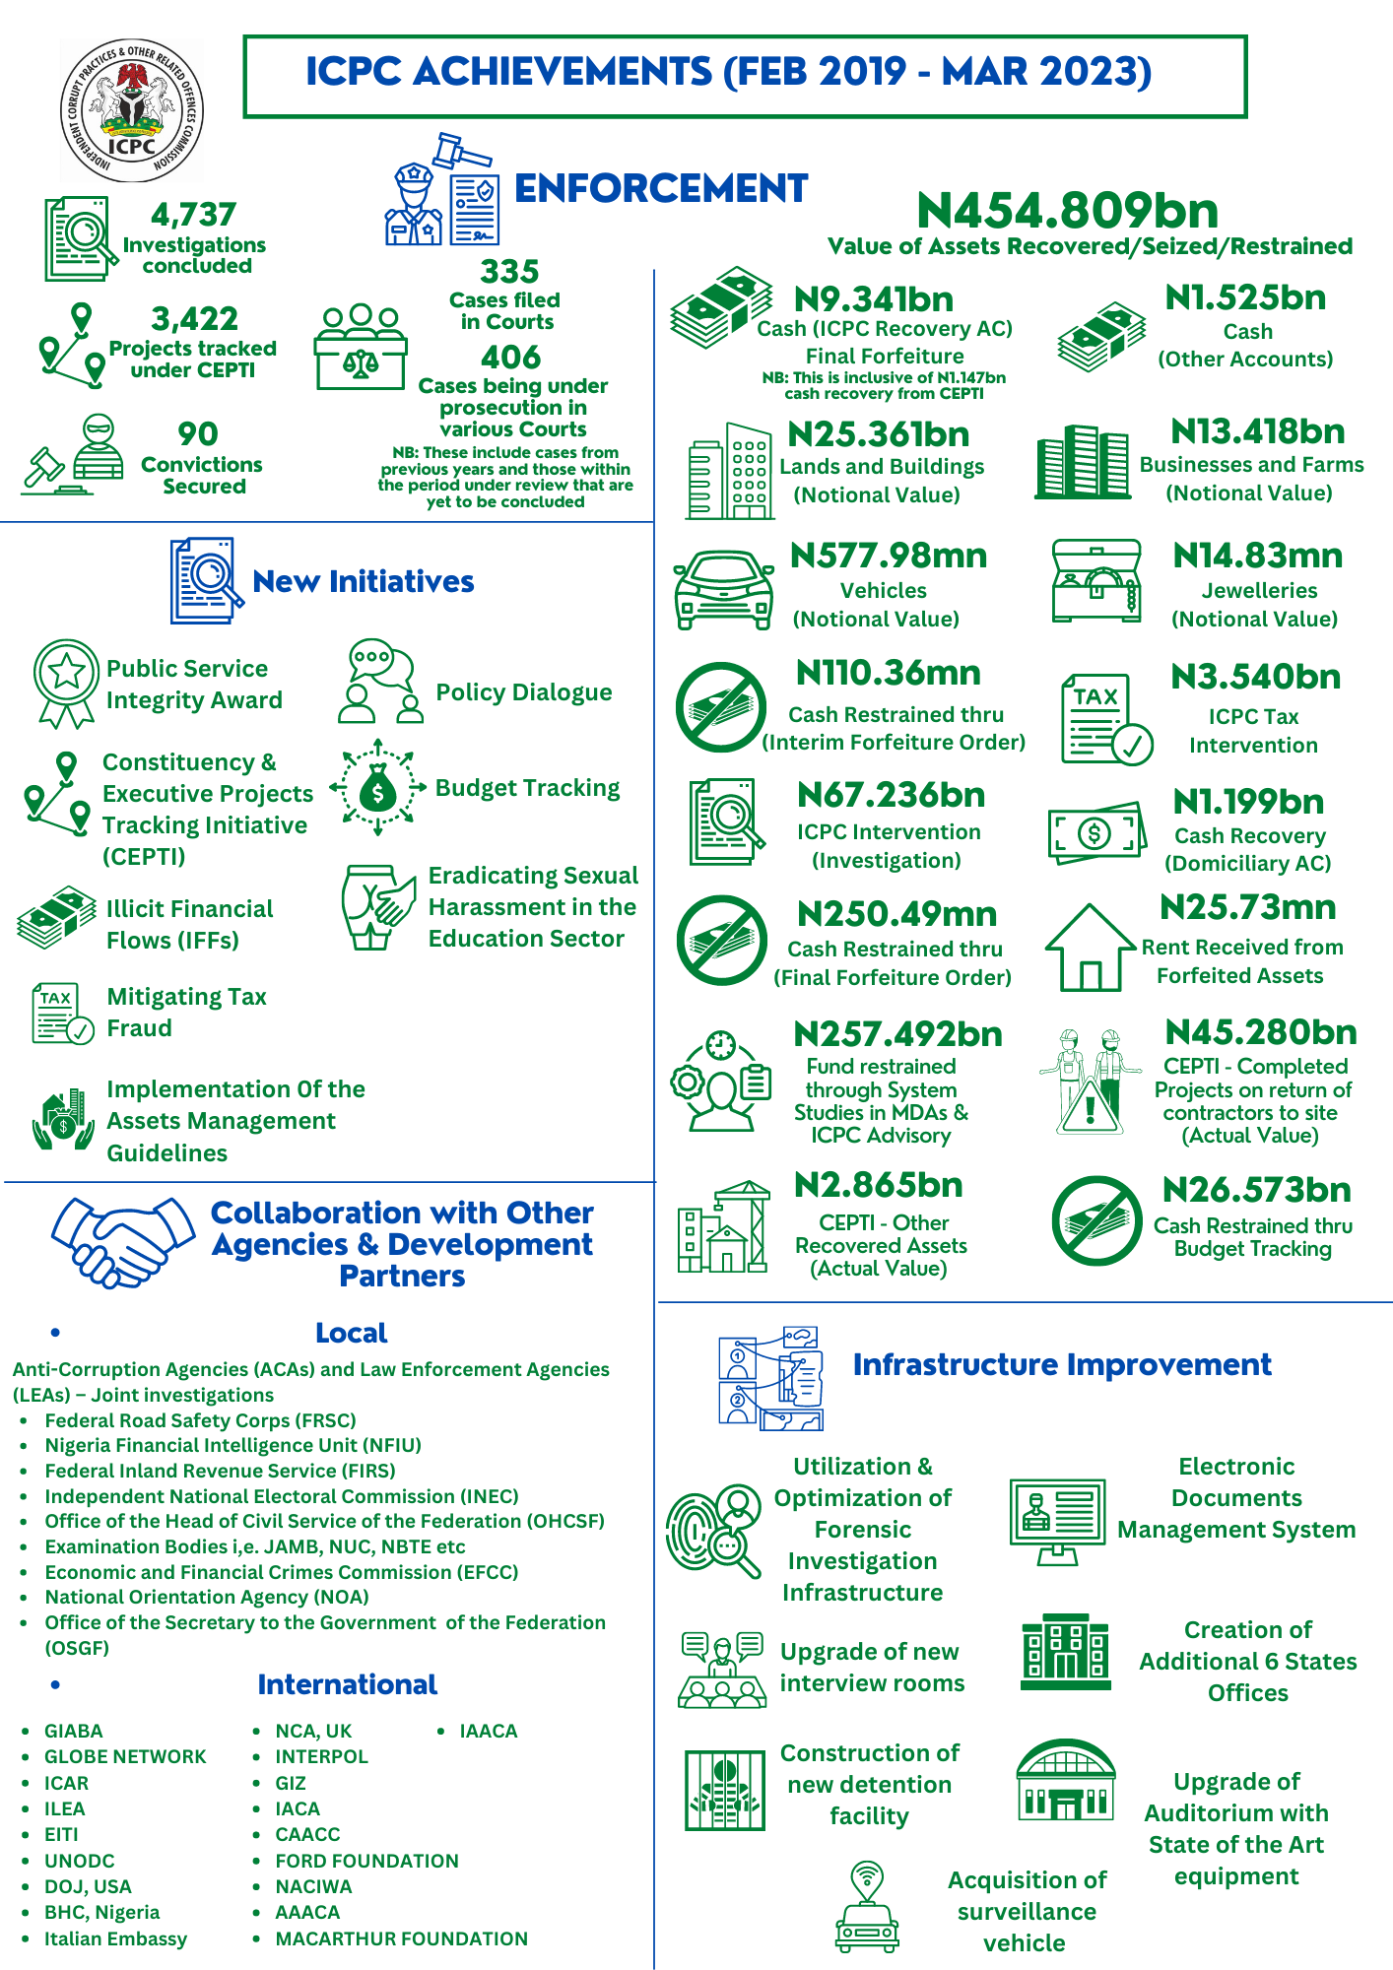

Slide 29
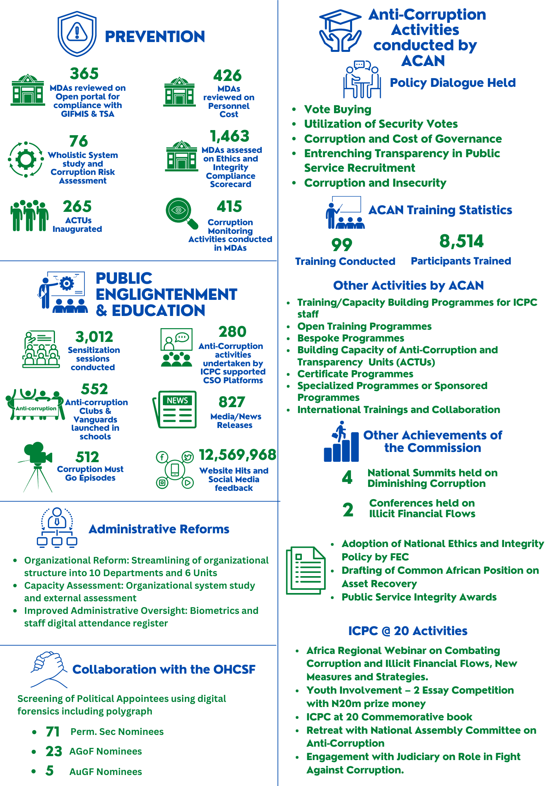

Slide 30
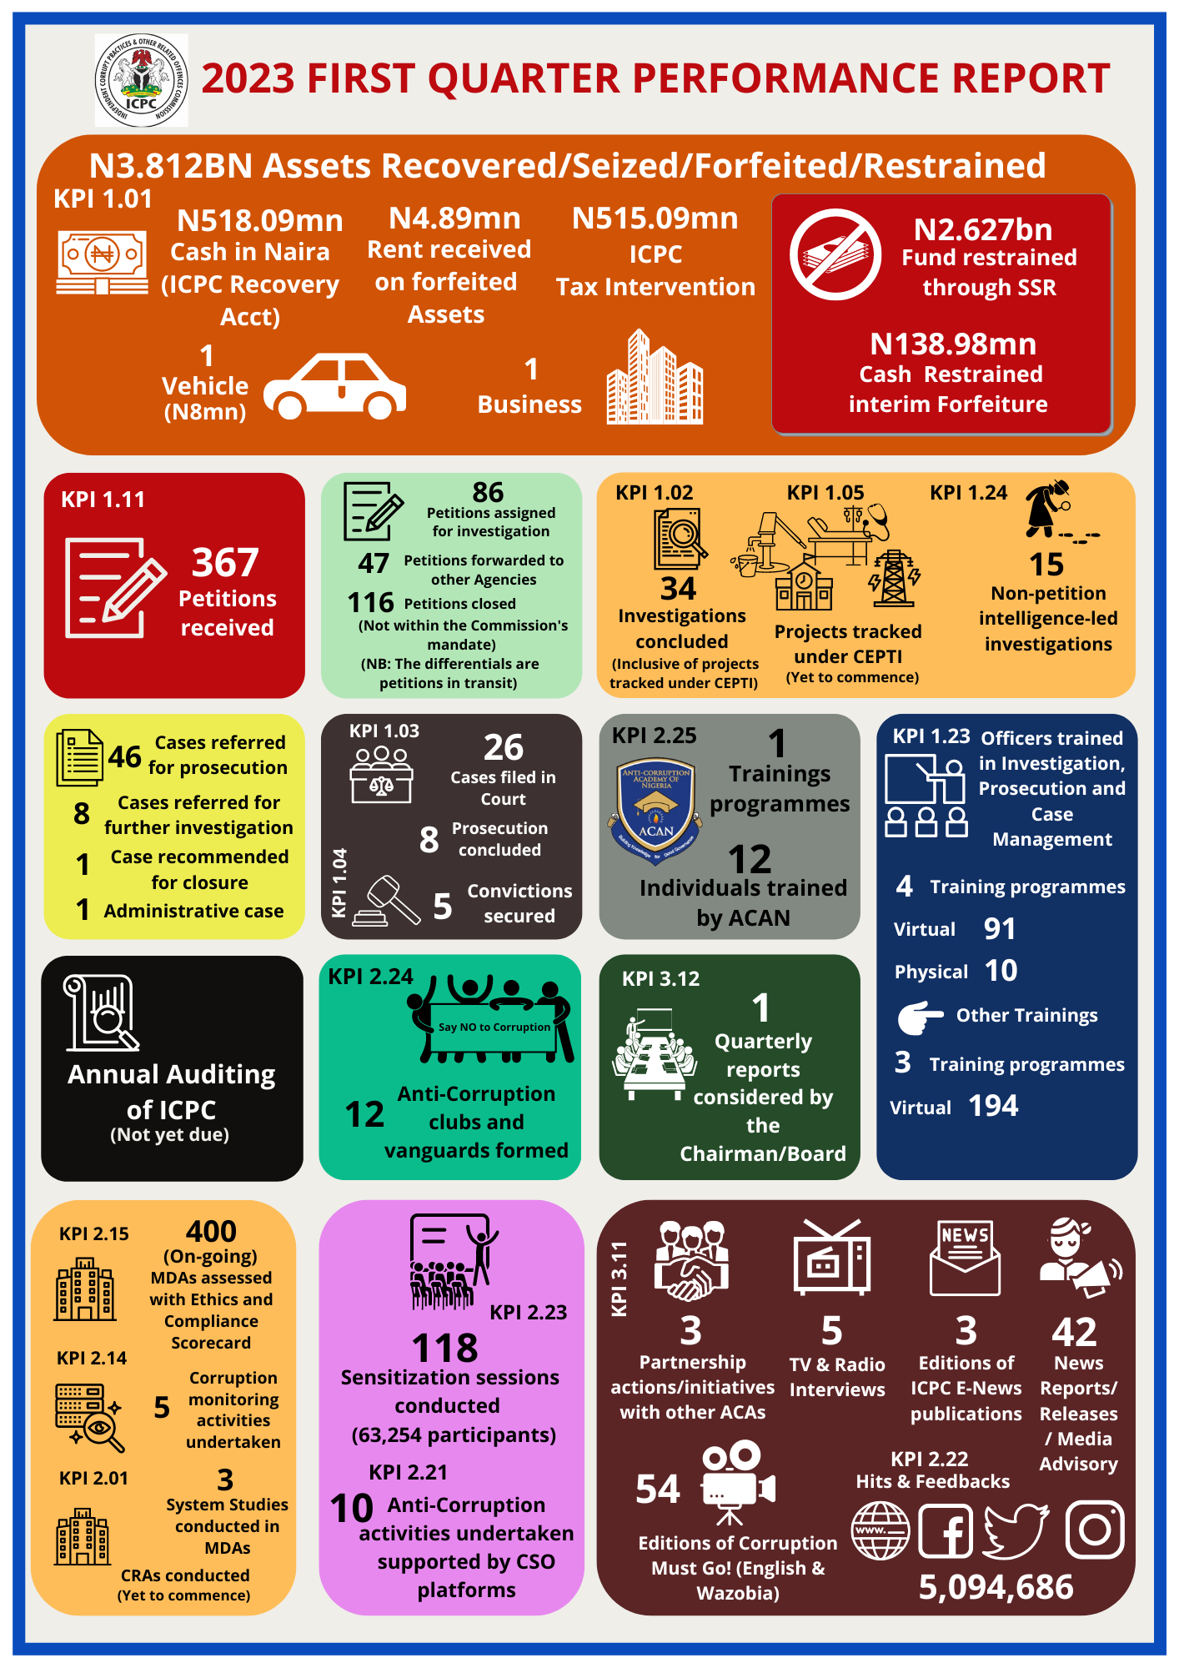

Slide 31
CHALLENGES

Slide 32
1. Implementation of the ICPC Strategic Plan 2019-2021: Key Findings: Weaknesses and Challenges
The advent of covid-19 pandemic affected the performance of some key performance indicators.
Fund constraints was noted to have affected the delivery of some activities and key performance indicators.
Some KPIs which the Commission did not have control over also affected the overall performance.
Time lag between the production of new policies/procedures adopted by the Board and the implementation of the policies/procedures.

Slide 33
1. Implementation of the ICPC Strategic Plan 2019-2021: Key Findings: Weaknesses and Challenges …/2
The non-submission of data by respective departments still pose a challenge to the M&E Team.
Inconsistent report of statistical data by some departments impairs the integrity of our data.

Slide 34
2. Alignment of the ICPC Strategic Plan 2019-2023 Key Findings: Weaknesses and Challenges
The M&E Framework of the ICPC Strategic Plan 2019-2023 only measures successes at output level and does not have strategies for measuring or demonstrating impact on sectorial basis to the general public.
The Plan also does not have strategies for accessing donor funds from international partners whose activities are linked to ICPC activities.
Some indicators in ICPC Strategic Plan do not have activities to drive them.
The Strategic Plan has ‘Improved rating of Nigeria on TI’s annual CPI’ as part of its KPI which it does not have control over.

Slide 35
2. Alignment of the ICPC Strategic Plan 2019-2023 Key Findings: Weaknesses and Challenges …/2
Mid-Term Evaluation Report did not recommend reward for departments or employees that reach certain targets as a motivating factor.
The virtual sensitization of state officers of Strategic Plan does not allow for effective interaction on the subject matter.
The NACS 2017-2021 does not have measurable Key Performance Indicators (KPIs) for various MDAs rather the only deliverables are the strategic activities assigned to the respective MDAs.
There is also no strong M&E Framework to follow through the implementation of NACS.
Just very few MDAs successfully aligned their Strategic Plan with NACS.

Slide 36
Recommended approach for Strategic Programming
Strategic Programming
A systematic approach for ACAs to being successful is made up of four components:
Goal
“What are we trying to achieve?”
Strategy
“How are we going to achieve it?”
Data
“Are we doing what we planned to do?
“Are we achieving what meant to achieve?”
Communication
“Are our achievements recognized and attributed to our work?”

Slide 37
3. Recommendations for the ICPC Strategic Plan 2024-2028 1. Goal “What are we trying to achieve?”
Definition of Objectives
Strategic Programming: To ensure objectives formulated in ICPC Strategic Plan 2024-2028 are realistic, achievable, and aligned with national level documents, in particular NACS – and where feasible, NDP
Definition of Indicators
Making success measurable: To incorporate strategies that will measure successes and performance beyond output level and demonstrates impact on sectorial basis.
Donor support and funding
Use ICPC Strategic Plan to access to donor funds from international partners whose activities are linked to ICPC activities.

Slide 38
3. Recommendations for the ICPC Strategic Plan 2024-2028 2. Strategy “How are we going to achieve it?”
Implementation of objectives
Aligning indicators and activities: Ensure that all key performance indicators have strategic activities that will drive their execution.
Management of Officers
Incentives and Sanctions: There may be need for application of carrot and stick approach for departments or employees that reach certain targets as a motivating factor.
Sensitization: To ensure that staff at the States offices are fully sensitized on the next Strategic Plan. Physical sensitization is preferrable to virtual to allow for active interaction.

Slide 39
3. Recommendations for the ICPC Strategic Plan 2024-2028 3. Data Monitoring: “Are we doing what we planned to do? Evaluation: “Are we achieving what meant to achieve?”
Quality of the Indicator Framework
KPIs must be suitable to Monitor and Evaluate the Commission’s work and success: to avoid incorporating KPIs and activities which it does not have control over in its next strategy.
Avoid the CPI as KPI: In particular the CPI is an indicator that is out of ICPC’s control due to its methodology. ICPC should have a plan for dealing with its results, but not use it as a Performance Indicator in our M&E framework

Slide 40
3. Recommendations for the ICPC Strategic Plan 2024-2028 4. Communication “Are our achievements recognized and attributed to our work?”
Creating tangible results
Connect ICPC‘s work to impact: for example, sector approaches can offer the opportunity of tying the Commission‘s work to real life results for Nigerians – such as better health care, etc.
Communicating Results
Incorporate a Communications Plan: ensuring that Nigerians are aware of how the Commission’s work contributes to their own well being will create support for our work. Including an explicit plan on how to communicate what results should be a key component of the ICPC Strategic Plan 2024-2028

Slide 41
Other Recommendations and Lessons Learned from the Project that are of interest
Recommendations for the next NACS:
Indicator Framework: The Commission to advise on the need to incorporate a robust M&E Framework in the next NACS.
Aligning and engaging MDAs through definition of deliverable indicators: The incorporation of deliverable indicators together with strategic activities for the respective institutions into the next NACS may stir up MDAs to arise to their responsibilities.
Defining deliverable and communicating responsibilities for MDAs: There is need for prompt and proper communication of responsibilities of various MDAs and their expected deliverables in next NACS document. This will help in ensuring proper alignment of NACS with the respective MDAs’ strategies.

Slide 42
CONCLUSION
In conclusion, it is not in doubt that the Commission has recorded great success within the past four years and three months under the 4th governing Board of ICPC. The result might not be perfect, but we have a reason to celebrate the success recorded while striving to improve on the identified areas for improvement.
I therefore indulge media practitioners to be part of the story sharers of ICPC performance and also critic us when the need arises for improved performance.

Slide 43
THANK YOU

