Slide 1
CORRUPTION AND THE COST OF GOVERNANCE IN THE EXECUTION OF GOVERNMENT PROJECTS
3rd National Summit on
DIMINISHING CORRUPTION IN THE PUBLIC SECTOR
30th November, 2021

Slide 2
INTRODUCTION
“Corruption poses a threat not only to the environment, human rights, democratic institutions, fundamental rights and freedoms, but also undermines development and deepens poverty for millions the world over. If it is allowed to continue……..corruption will deny that most fundamental of human needs– Hope”. Peter Eigen, TI

Slide 3
INTRODUCTION CONT’D
Institutionalization of corruption
Corruption and Governance
Notes:
By design and conceptualization, Government projects, be it ZIP (Zonal Intervention) or Executive (capital) are meant to address infrastructural deficit and provide social amenities to the citizens.
To achieve this, successive administrations have continued to appropriate funds in each budget cycle a minimum 100bn for constituency projects and trillions for the other capital projects.

Slide 4
INTRODUCTION CONT’D
The question;
Has the implementation of these projects positively impacted on the lives of Nigerians, or are these projects further deepening our collective woes as a country?

Slide 5
COST OF CORRUPTION
According to Transparency International,
Corruption, bribery, theft and tax evasion, and other illicit financial flows cost developing countries $1.26 trillion per year.
This is roughly the combined size of the economies of Switzerland, South Africa and Belgium, and enough money to lift the 1.4 billion people who get by on less than $1.25 a day above the poverty threshold and keep them there for at least six years.

Slide 6
CONCEPTUAL CLARIFICATION
Cost of Governance simply means what it costs government to run its administrative structures as well as its developmental programmes and projects.
Corruption: raises the cost of governance and the negative impact of corruption on the cost of governance is the cost of corruption.

Slide 7
COST OF CORRUPTION CONT’D
The effective assessment of loss and damage due to corruption requires the consideration of the following:
Corrupt activity that has occurred on or in connection with the project;
Stakeholders that has suffered loss and damage as a result;

Slide 8
COST OF CORRUPTION CONT’D
The types of loss and damage that has been suffered by each stakeholder
The amount of each type of loss and damage suffered by each stakeholder with respect to each corrupt activity.

Slide 9
COST OF CORRUPTION CONT’D
Losses and damage to the Government:
Theft/Misappropriation of project funds
Waste of public funds on non-viable projects
Abandonment of projects
Over-invoicing

Slide 10
COST OF CORRUPTION CONT’D
Increased maintenance, repair and replacement cost
Loss of credibility and investment opportunities
Total or partial loss of investment
Insecurity etc.

Slide 11
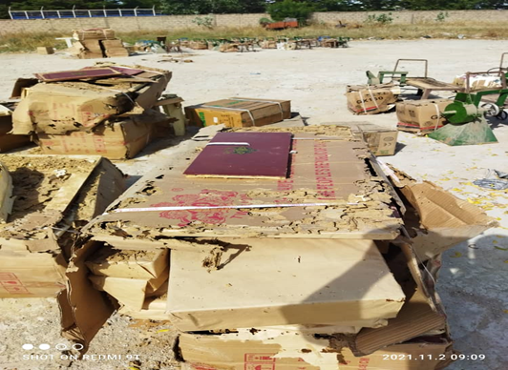

Slide 12
CONSTITUENCY AND EXECUTIVE PROJECTS TRACKING INITIATE
Background
Funding
The Initiative (CEPTi)
Implementation

Slide 13
COST OF CORRUPTION CONT’D
HIGHLIGHTS OF FINDINGS
Non-execution/shoddy execution of projects
Project round-tripping
Double appropriations for same project
Conversion of projects to private use
Absence of Needs analysis/synergy
Passing off projects

Slide 14
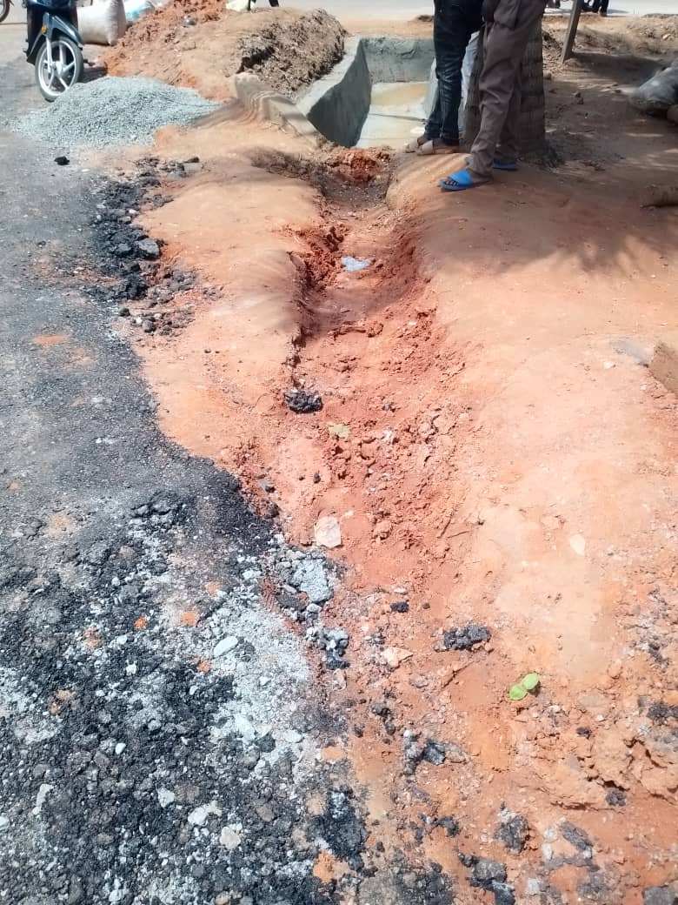
Shoddy projects execution

Slide 15
THE WAY FORWARD
Transparency and Accountability
All branches of government must institute key reforms and make obvious regulatory fixes
Community involvement and ownership

Slide 16
THE WAY FORWARD CONT’D
All requests for projects by facilitators and MDAs should be submitted to an online platform created solely for this purpose.
Early Public Disclosure.
Declaration of no Financial Interest.
Demonstrations of Community Engagement in the entire process.

Slide 17
THE WAY FORWARD CONT’D
Financial Interest Disclosure: facilitating legislators and heads of MDAs must certify to the appropriate Committee by a sworn affidavit that they, their spouses, and their immediate family have no financial interest in the projects they request.
Demonstrations of Community Engagement: Facilitating legislators as well as implementing MDAs must provide evidence of community support that were the compelling factors in their decision to select the requested projects.

Slide 18
Community Engagement

