Slide 1
Nigeria's Fight Against Corruption, Asset Recovery, and Integrity Index
Dr. Musa Adamu Aliyu, SAN - Chairman, ICPC
7th AGM of the Association of African Anti-Corruption Authorities (AAACA), Algiers, Algeria | July 21-22, 2025

Slide 2
Opening and Acknowledgement
Your Excellencies, distinguished colleagues, it is a great honour to join you today in Algiers.
The AAACA continues to provide an invaluable platform for us to learn from each other, strengthen bonds, and forge unified strategies in our shared fight against corruption across Africa.
Nigeria stands committed to this cause and is here to share experiences, not just successes, but lessons from challenges as well.

Slide 3
Nigeria’s Anti-Corruption Journey: Evolution and Commitment
Nigeria's anti-corruption story began formally in 1975 with the Corrupt Practices Decree.
A major leap came with the return to democracy in 1999, when President Obasanjo made anti-corruption a priority.
Key institutions like ICPC (2000) and EFCC (2004) were established.
Over the years, we've shifted from reactive prosecution to proactive prevention, public education, and systems reform.
The National Anti-Corruption Strategy (NACS) now guides a multi-stakeholder, whole-of-society approach.

Slide 4
Challenges Along the Way: A Realistic Appraisal
Despite robust frameworks, implementation has been uneven.
We face politicisation of cases, capacity weaknesses in some institutions, and the entrenchment of corrupt practices in daily life.
These realities motivate, rather than discourage, our reform agenda and push for stronger systems.

Slide 5
Asset Recovery: Reclaiming What Was Stolen
Nigeria recognises that stolen wealth undermines development.
Asset recovery is central to our anti-corruption strategy.
Agencies like ICPC, EFCC, and the Police now actively trace, seize, and forfeit illicit assets.
The Proceeds of Crime Act (2022) and Asset Tracing Regulations (2019) have strengthened our framework.
But challenges remain around coordinated management and transparent disposal of recovered assets.

Slide 6
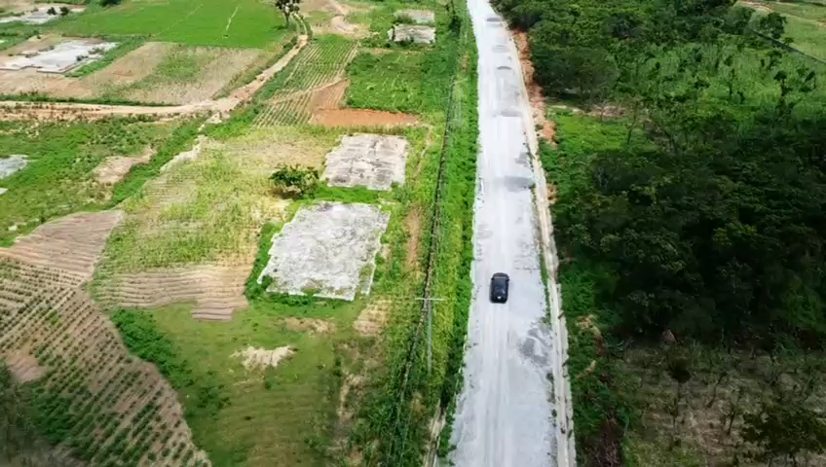
Asset Recovery

Slide 7
Managing Recovered Assets: Moving Towards Best Practices
Past concerns over poor handling of recovered assets led to the creation of the Asset Recovery Management Unit.
Nigeria is aligning with international best practices (World Bank’s StAR Initiative):
  Declare recovered assets publicly.
  State their intended use.
  Report how they are spent.
  Audit them timely and transparently.

Slide 8
International Cooperation: Essential for Cross-Border Recovery
Given the transnational nature of corruption, Nigeria engages in bilateral and multilateral asset recovery efforts.
Mutual Legal Assistance and bilateral treaties have led to some repatriation success stories.
However, delays due to complex foreign legal systems and lack of uniform standards remain a challenge.
Nigeria continues to advocate for quicker, more transparent international processes for asset return.

Slide 9
Nigeria on Integrity Indexes: Reading Between the Rankings
Nigeria’s CPI score has seen a slight improvement, moving from 145th to 140th globally.
However, a score of 26/100 is far from satisfactory.
This underlines the importance of accelerating reforms, increasing public trust, and delivering visible results.

Slide 10
ICPC’s Strategic Innovations and Initiatives
Nigeria Corruption Index (NCI): Our own homegrown index, under development, will offer granular data on sector-specific corruption to inform better strategies.
CARE for Impact Strategy: This is our flagship approach at ICPC, focused on Culture, Accountability, Responsibility, and Efficiency — to promote integrity, not just punishment.
Prevention-first mindset: System reviews, integrity training, and ethics in public service are now central to our prevention efforts.
Public Education: We are investing in youth education, social media campaigns, and community mobilisation to build a culture of zero tolerance for corruption.
Partnerships: We are working closely with CSOs, the private sector, and international partners to broaden the impact of our work.
Judicial Integrity: I consistently advocate for transparent and moral appointments of judges—a credible judiciary is the backbone of any anti-corruption regime.

Slide 11
Conclusion: A Call for Shared Commitment
Nigeria’s fight against corruption is a story of resilience and renewal.
We know the road is long, but we are focused on solutions, not excuses.
We must all continue to collaborate, share, and support each other.
Let us remain committed to building an Africa free of corruption, one reform at a time.

Slide 12
Conclusion
I thank the AAACA for this opportunity and look forward to learning from fellow African leaders.
Together, let us keep the flame of integrity burning across the continent.

