Slide 1
FEDERAL MINISTRY OF HUMANITARIAN AFFAIRS, DISASTER MANAGEMENT AND SOCIAL DEVELOPMENT
ICPC & OAGF Meeting: Delivering Palliatives Transparently: Cash Transfer in Focus
May 2020
Iorwa Apera
National Coordinator

Slide 2



Background and Introduction
The Federal Government of Nigeria of Nigeria (FGN) has prioritized social protection (SP) interventions as a key strategy towards reducing poverty and socio-economic vulnerabilities in the population.
In line with this, the government in partnership with the World Bank has designed the National Social Safety Net Project (NASSP); aimed at dedicating national resources to improve the lives of citizens and strengthen the role of social protection in helping to distribute resources more broadly.
To implement NASSP, the Government has established a National Social Safety Net Coordinating Office (NASSCO) Under the oversight and coordination of the Federal Ministry of Humanitarian Affairs , Disaster Management and Social Development. NASSCO supervises the implementation of the National Cash Transfer Programme, by the National Cash Transfer Office (NCTO)

Slide 3


NASSP Components
NASSP
Establishing the building blocks for a National Social Safety Net System
Implementing a Targeted Cash Transfer

Slide 4
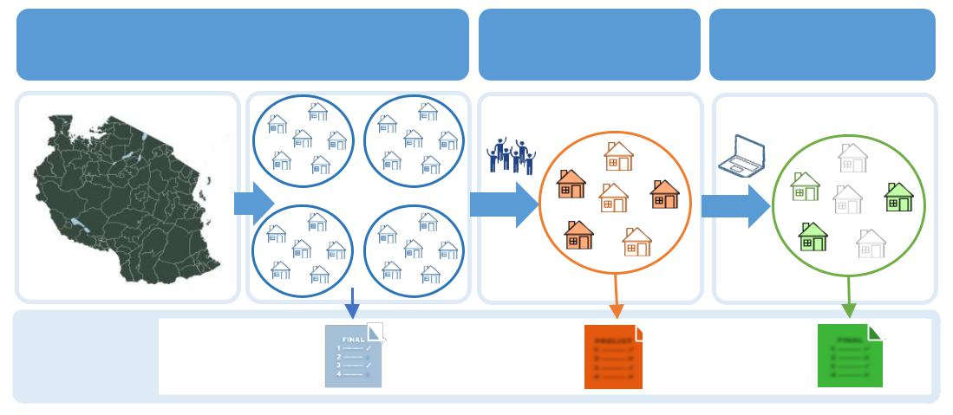
Targeting Mechanisms
2. Community-Based
Targeting
3. Proxy Means Test
1. Geographical Selection
Outputs
Quotas by LGAs
Identified List
Ranked HHs List
Notes:
Community-based targeting is a new concept in Nigeria but not in the world. Different countries over the world (such as Rwanda, Indonesia and Philippines) who have undertaken different programmes of SSN have already observed the positive impacts of CBT and hence why this was also chosen as the primary targeting mechanism for Nigeria, which is also one of the hallmarks of NASSP.
CBT aims to ensure that interventions are targeted only at the poorest communities, uses community knowledge to reach the poorest households within the selected communities to minimize exclusion errors.

Slide 5
THE NSR Vs NBR
 | National Social Register | National Beneficiary Register
Purpose | Registering individuals, households and determining potential eligibility | Tracking beneficiaries and underpinning program management including benefits administration payments, case management, conditionality monitoring.
Population Covered | All applicants, whether or not deemed eligible for social programs | Beneficiaries only
With Multiple Programs | A gateway for people to apply for multiple programs | Distinct program specific registers but could be integrated at the back-end.
.
National Social Safety-Nets Coordinating Office (NASSCO)

Slide 6
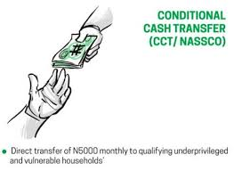
Targeted Cash Transfer Program
Base Cash Transfer
Households (HHs) who fall within the 6th decile and above in the NSR, based on the PMT ranking, are eligible, and enrolled into the National Beneficiaries Register (NBR) for CCT payment.
Co-Responsibility/Cash Transfer Top-Up
Beneficiary households are eligible for an additional transfer of NGN 5000 per month if they satisfy a set of specified co-responsibilities linked to the use of public services. Beneficiaries will attend behavioral change training before they are asked to comply with using certain basic services.
TRAININGS
Savings Group Mobilization, SBCC , Life-Skills, Micro-Business, Mentoring and Coaching

Slide 7
Accountability and Transparency Mechanisms for Delivering the Cash Transfer
NASSP is built on strong Transparency, Social Accountability and Citizen Engagement principles including:
    Third-Party Monitoring by CSOs to ensure more transparency and accountability in the use of resources
    Quarterly CCT Payment Audits by Office of the Auditor General of the Federation
    Engagement of National External Audit Firm for semester payment output audit
    Engagement of the ICPC and DSS in field monitoring of payments
    Strong Financial management system and services provided by Office of the Accountant General of the federation
    Grievance Redress Mechanism
    Strong internal control system including World bank semester monitoring missions.

Slide 8









NASSP TPM Monitoring Flowchart
TPM Field Monitoring using standardized tools
Report sharing and analysis
TPM Implementation – State TPM
NASSP Implementation team
TPM Field Monitor(s)
Zonal Tech. Lead
Community
Consolidated monthly states TPM Monitoring Report
CHEERS Tech. Team
NASSCO
TPM Implementation Report
TPM Field Monitor(s)
Quarterly technical report & score card published
Monthly technical report Score card generated
Technical Support & Oversight

Slide 9
Validation of Actual Beneficiaries Paid
Data collection is deployed to non-contiguous communities on the program. In this way that the reach and spread of information cuts across different communities and beneficiaries.
NASSCO NSR has a unique NSR Number and each HH is geo-tagged
Each HH has a barcode that can be scanned, and each barcode has all the detailed information for HH and alternates
Data collectors used the GPS to locate the HHs independently
The Barcode was scanned and all HH information popped up with pictures which was then confirmed by the monitors physically. If confirmed, the interview proceeds otherwise it is not validated
Key Informant Interview (KII)/FGD tools were deployed particularly to target beneficiary complaints and unresolved/lingering complaints on the program.

Slide 10
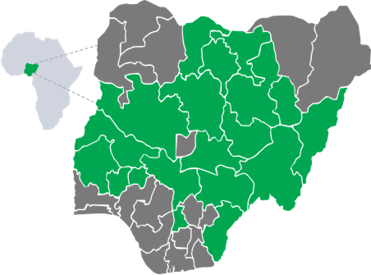
Third Party Monitoring
NASSP TPM States (19)
Two Cycles of NASSP TPM exercise conducted
  Q1 in 11 states – November 2019 across 133 LGAs
  Q2 in 19 states – February 2020 across 256 LGAs
A total of Four Hundred and Sixty-two Thousand, Nine Hundred and Ninety-three (462,993) Beneficiaries were sampled from 19 states
10% of the above total was selected for monitoring the monitoring cycles(s)
Mixed method instrumentation was used (Quan & Qual) collect data
Findings & recommendations from the two rounds (January & March 2020) was presented and disseminated to NASSP and will be made public in about a week or two
Katsina
Jigawa
Kano
Kaduna
Bauchi
Gombe
Niger
Adamawa
Kwara
Plateau
Nasarawa
Oyo
Kogi
Taraba
Ekiti
Osun
Benue
Anambra
Cross Rivers
Covered
Not Covered

Slide 11
THANK YOU

