Slide 1
CURBING CORRUPT PRACTICES AND UNETHICAL VALUES IN NIGERIAN TERTIARY INSTITUTIONS: THE INFORMATION COMMUNICATIONS TECHNOLOGIES (ICT) APPROACH
BY
PROFESSOR GODWIN ONU
RECTOR
FEDERAL POLYTECHNIC, OKO
ANAMBRA STATE
20TH AND 21ST OF MAY, 2014

Slide 2
Creativity and Service…
Introduction
Ordinarily education is expected to have the capacity to incorporate sustainable development values and practices into core activities of teaching and research, institutional management and operational systems. By sustainable development, we mean “Development which meets the needs of the current generation without compromising the ability of future generations to meet their needs” (UN, 1989).
Overtime, unethical practices have affected the fortunes of our educational system in Nigeria, which (though controversial) is perhaps on its lowest ebb now.
rector@federalpoloko.edu.ng www.federalpolyoko.edu.ng

Slide 3
Creativity and Service…
Corrupt Practices in Tertiary Institutions
Extortion of students by staff
Underserved of award of scores after examination
Gratification
Indecent dressing
Political interference in management of Institutions
Godfatherism
Special requests for admission and employment
Value system and orientation on part of staff and students
Social media
Overcrowding during examinations and inadequate facilities for examinations
Channeling greed towards public office
rector@federalpoloko.edu.ng www.federalpolyoko.edu.ng

Slide 4
Creativity and Service…
Other Challenges…
Funding
Poor infrastructure
Incessant strike by labour unions
Host community interference in the management of tertiary institutions
Religious dichotomy
Ethnicity
We versus them dichotomy
Cultism.
Labour Unions and inherent abuses
rector@federalpoloko.edu.ng www.federalpolyoko.edu.ng

Slide 5
Creativity and Service…
Our Solution: The ICT Approach
Most if not all the areas of infractions identified at tertiary institutions in Nigeria could be addressed by the instrumentalities of information communications technologies as portrayed in the following analyses:
Sexual harassment and sale of academic handouts could be squarely addressed with flexible learning where learners are offered a variety of options for personalizing the learning experience based on their specific needs and preferences. To increase flexibility, therefore, means essentially to overcome obstacles emerging from the rigidity of traditional forms of education by enabling learners to select what is best for them with respect to key dimensions of learning (Collis & Moonen, 2001) through digital lectures and e-lectures that minimize contact between students and lectures.
Setting of tough examination questions, admission syndicates and racketeering financial inducement and gratification, examination malpractices at the tertiary level of education and massive churn out of first class degrees could be checked through Computer-Based Testing (CBT) or e-examination. It is a method of administering tests in which the responses are electronically recorded, assessed, or both.
rector@federalpoloko.edu.ng www.federalpolyoko.edu.ng

Slide 6
Creativity and Service…
Our Solution: The ICT Approach Contd.
With digitalized processes and procedures at tertiary institutions in the country:
Students’ records in school databases can be easily accessed, managed and updated as at when due
Also computing and retrieving result of students for issuance of certificates would be carried out on real time basis
Information about students would be accurate since it is usually updated every semester and the tracking of student files, cumulative assessments, scores of assignments as well as examinations would be recorded effectively and efficiently
The databases would enable the students to check their performances at the end of each semester at will and on demand, such that they would have access to their results and comments from their lectures, including their grades
rector@federalpoloko.edu.ng www.federalpolyoko.edu.ng

Slide 7
Creativity and Service…
Practical Solutions
Biometric Time Clocks (also known as Fingerprint Readers)
Time and Attendance Software
Online fee Collections
rector@federalpoloko.edu.ng www.federalpolyoko.edu.ng

Slide 8
Creativity and Service…
Other forms of Corruption
Pre Examination Malpractice
Examination Malpractice
Post Examination Malpractice
Corruption during Staff Appraisal
rector@federalpoloko.edu.ng www.federalpolyoko.edu.ng

Slide 9
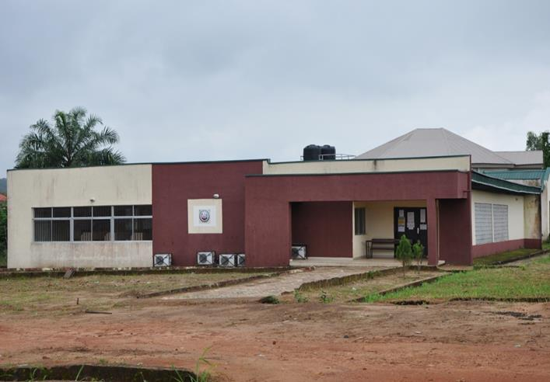
Creativity and Service…
The Federal Polytechnic Oko Experience
Petroleum Development Trust Fund (PDTF) ICT/E-Examination Centre where Public Administration department students did their first semester CBT examination.
rector@federalpoloko.edu.ng www.federalpolyoko.edu.ng

Slide 10
Creativity and Service…
The Merits of CBT
CBT guarantees efficiency in examination delivery, administration and scoring
It also reduces the need for resources for many elements in testing
CBT ensures that results are released almost immediately
Allows constant continuous assessments and better learning outcomes
It will eliminate examination malpractices and maladministration
Facilitates dedication and effective teaching and learning
Examination malpractices, low capacity examination venues, inadequate invigilators, inadequate examination materials, omission of students results and human error(s) during the marking/grading process will be automatically eliminated
rector@federalpoloko.edu.ng www.federalpolyoko.edu.ng

Slide 11
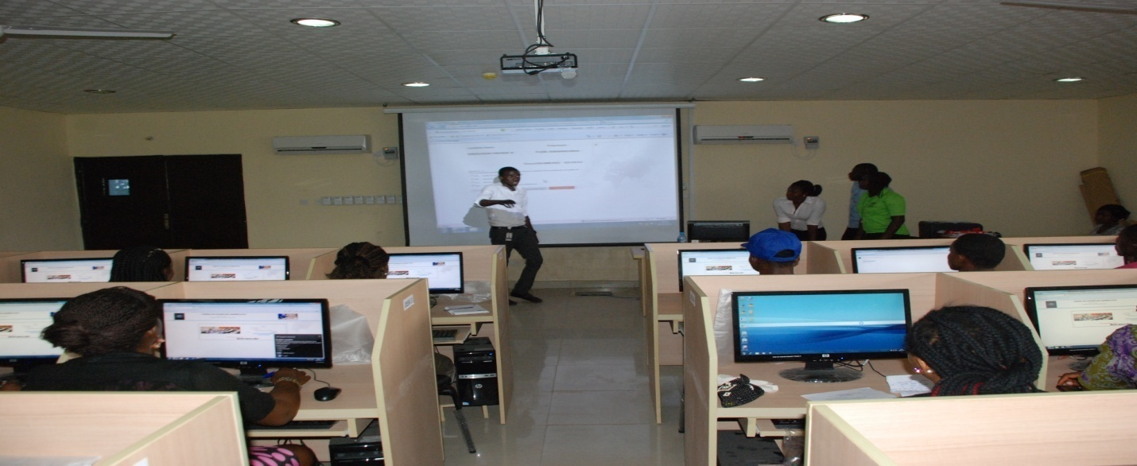
Creativity and Service…
The Federal Polytechnic Oko Experience
Orientation Course on CBT for students
rector@federalpoloko.edu.ng www.federalpolyoko.edu.ng

Slide 12
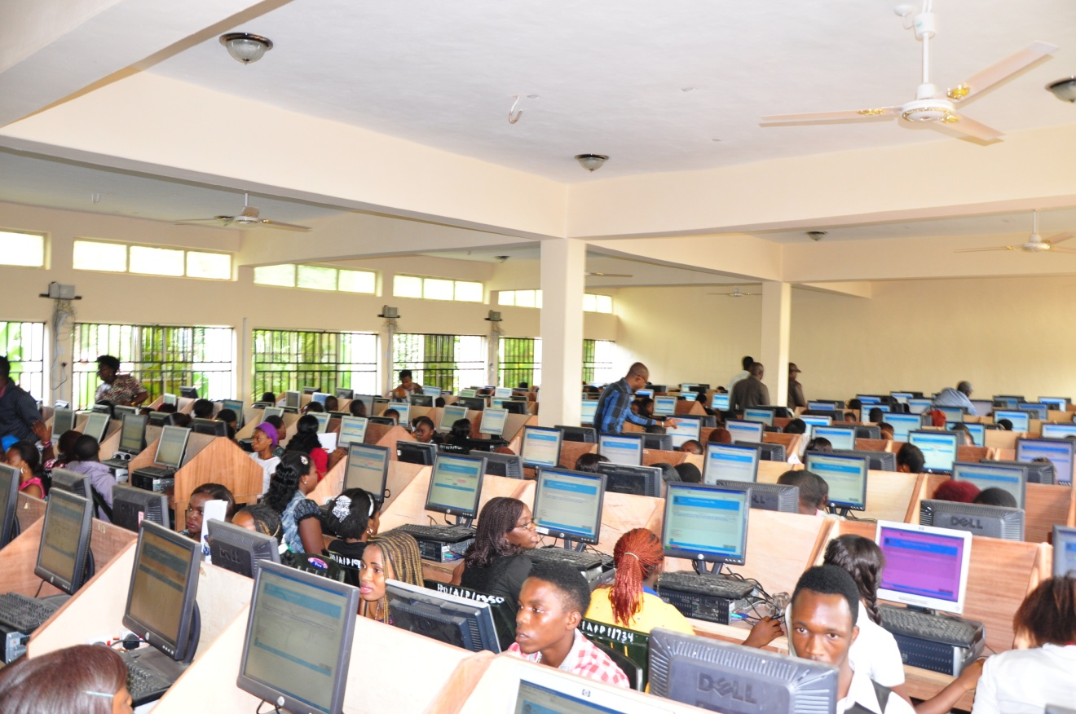
Creativity and Service…
The Federal Polytechnic Oko Experience
Prospective candidates for admission into the Polytechnic during the Post Unified Tertiary Matriculation Examination (PUTME)
rector@federalpoloko.edu.ng www.federalpolyoko.edu.ng

Slide 13
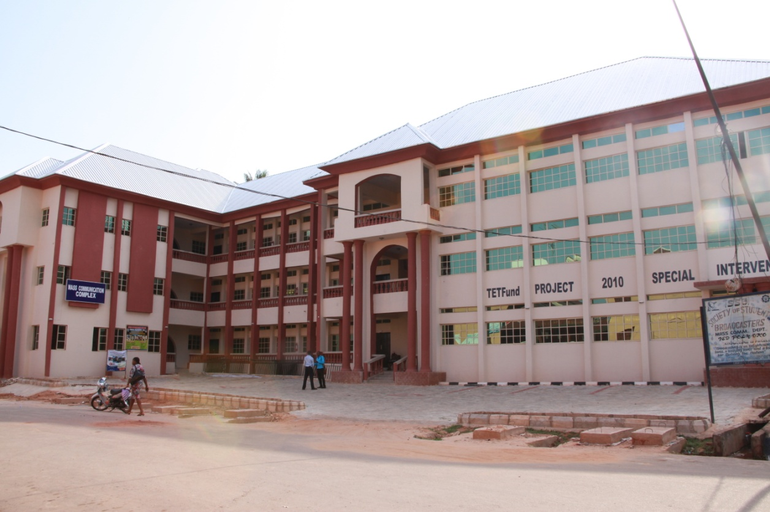
Creativity and Service…
The Federal Polytechnic Oko Experience
New Mass Communication Complex (Tetfund Special Intervention) that houses one of the Polytechnic Electronic Examination Centres at the moment
rector@federalpoloko.edu.ng www.federalpolyoko.edu.ng

Slide 14
Creativity and Service…
Some Institutions that have adopted CBT partially or fully in Nigeria to our knowledge
University of Ilorin, Kwara State
National Open University of Nigeria (NOUN)
Federal University of Technology, Minna
Federal University of Technology, Akure
University of Lagos, Lagos State
University of Agriculture, Makurdi
University of Maiduguri, Borno State
University of Ibadan, Oyo State
University of Nigeria, Nsukka
Covenant University, Ota
Federal Polytechnic, Oko
Joint Admission and Matriculation Board (JAMB)
rector@federalpoloko.edu.ng www.federalpolyoko.edu.ng

Slide 15
Creativity and Service…
Recommendations
The establishment of a National Committee to work out modalities and framework for the adoption of computer based testing (CBT) method of examination in all schools, colleges, polytechnics and universities in Nigeria as a panacea to examination malpractice and re-building quality education in Nigeria.
It is further recommended that a national policy on Information Communication Technology and Computer-Based Test (ICT-CBT) method of teaching-learning-examination management and administration be developed to provide ICTs in tertiary institutions for improved standard of education.
rector@federalpoloko.edu.ng www.federalpolyoko.edu.ng

Slide 16
Creativity and Service…
Conclusion
Even though it might be expensive to install ICT technology, it could be used with almost zero marginal cost. ICT has also improved the quality of tertiary education because it provides new innovative methods of interaction and sharing of information. To benefit from the numerous opportunities offered by the adoption and use of ICT in carrying out tertiary institution’s functions, institutions must be e-ready.
rector@federalpoloko.edu.ng www.federalpolyoko.edu.ng

Slide 17
Creativity and Service…
Thank You
rector@federalpoloko.edu.ng www.federalpolyoko.edu.ng

