Slide 1
NATIONAL CONFERENCE ON TRANSPARENCY, ACCOUNTABILITY AND ETHICAL VALUES IN TERITARY INSTITUTIONS SHERATON HOTEL, ABUJA MAY 21-22 2014
CHALLENGES IN THE MANAGEMENT AND FUNDING OF TERTIARY INSTITUTIONS
PROF MUNZALI JIBRIL, FNAL, FNESA, FNIM, FLAN, OFR
COORDINATOR POLICE ACADEMY, WUDIL, KANO STATE

Slide 2
ABSTRACT-1
The paper explores the challenges of managing and funding tertiary institutions in Nigeria: Polytechnics, Colleges of Education and Universities which are owned by the Federal Government, State Governments and private entities.
The management challenges include lack of formal training in management on the part of the academic leaders and mangers of these institutions. In public institutions, the existence of Governing Councils which add no value but become a burden on the institutions sucking up the little that is allocated by Government is a major challenge. In private institutions, the existence of an overbearing proprietor who usurps the powers of Council and Management is the most serious management challenge

Slide 3
ABSTRACT-2
The funding challenges across all institutions and regardless of proprietor are similar but differ in degree. All the tertiary institutions tend to be chronically under-funded but the Federal institutions and top-of the-range private institutions tend to be relatively well resourced. The least resourced institutions tend to be State Government-owned and the struggling private institutions where the profit motive is paramount.

Slide 4
ABSTRACT-3
The paper recommends that the mechanism for institutional accreditation by NUC be strengthened to include a detailed verification of management and funding performance indicators which can be used to impose appropriate sanctions on those which fail to meet the minimum prescribed management and funding standards

Slide 5
MANAGEMENT CHALLENGES IN POLYTECHNICS AND COLLEGES OF EDUCATION
Lack of formal management training for HOD’s. Deans and Principal Officers
Slow growth in student enrolment at an average of 5% between 2006 and 2009 in Colleges of Education and decline in student enrolment in Polytechnics over the same period of about 5% annually
Critical teacher shortages of up to 57% in Polytechnics and Colleges of Education
60% of Lecturers in Polytechnics do not possess a higher degree

Slide 6
MANAGEMENT CHALLENGES IN POLYTECHNICS AND COLLEGES OF EDUCATION-2
55% of Lecturers in Colleges of Education do not possess a higher degree; only 5% possess the PhD and only 40% possess the Master’s degree
In public Polys and COE’s, Governing Councils often become part of the problem by increasing the financial burden of the institutions instead of attracting financial support and facilitating endowments
In State Polys and COE’s, interference in management from the State Government is a major inhibiting factor
The implementation of the Procurement Act is hampered in some Federal institutions by the insistence of Councils to get involved in the procurement process

Slide 7
MANAGEMENT CHALLENGES IN POLYTECHNICS AND COLLEGES OF EDUCATION-3
Militant unionism, and the consequent distortion of the academic calendar, have crept into Polys and COE’s from the Universities since the only language Government appears to understand is that of strikes
Federal Polys and COE’s tend to be better resourced than State ones and these in turn tend to be better resourced than private ones
State Polys and COE’s tend to have a fire brigade approach to accreditation: they hurriedly mobilize to provide resources at the last minute only when an accreditation visit from the regulatory agency is imminent

Slide 8
GROWTH OF NIGERIAN UNIVERSITIES
Presently there are 129 universities in Nigeria consisting of 40 Federal, 39 State and 50 private.
In terms of enrolment, the Federal universities tend to dominate with an average enrolment of 20,000 followed by the State universities. Private universities, though more numerous, tend to have enrolment in the region of 3000-5000. Owing to high fees charged by them, no private university has attained the 10,000 enrolment mark; their share of total enrolment is below 5%

Slide 9
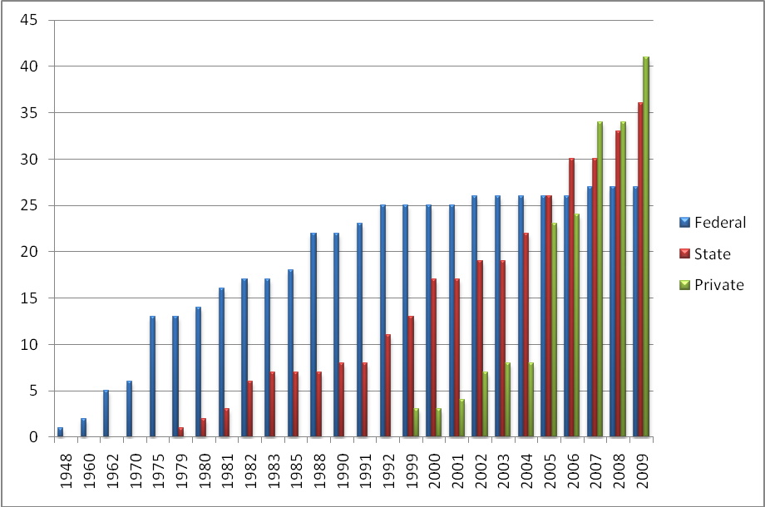
Notes:
Pattern of growth of Nigerian Universities: Source NUC Report on Sustainable Funding of Universities 2010

Slide 10
MANAGEMENT CHALLENGES IN UNIVERSITIES-1
As in Polys and COE’s, there is hardly any formal management training for academic leaders with consequent disastrous impact on the management of the institutions
Areas of training need include financial and resource management, fund-raising skills, crisis avoidance and crisis management skills and legal issues in higher education management
Federal and State Universities are under continuous pressure to expand enrolment without corresponding expansion in facilities and this leads to loss of quality

Slide 11
MANAGEMENT CHALLENGES IN UNIVERSITIES-2
Cultism is a major challenge especially in areas of the country where similar practices are part of the traditional culture.
In most public universities, few, if any, new student hostels have been built in the last 30 years thereby worsening the congestions in the hostels; poor living conditions tend to create uncouth students who behave irresponsibly
As in the Polys and COE’s, Governing Councils tend to be an additional financial burden on the universities in public universities

Slide 12
MANAGEMENT CHALLENGES IN UNIVERSITIES-3
Administrative autonomy has been granted to the Federal universities to appoint their VC’s etc but this is posing new challenges of accountability in the corrupt Nigerian environment
As in the Polys and COE’s. the implementation of the Procurement Act has been hampered by the insistence of some Councils to be involved in the procurement process
The Education Roadmap estimates that there is a shortfall of up to 42% in academic staffing in the universities with the Federal Universities being better endowed than the State Universities which are in turn better endowed than the private ones
The Roadmap also estimates that up to 50% of university lecturers do not possess the doctorate degree
The academic calendar in public universities has become a toy in the hands of the trade unions, especially the Academic Staff Union of Universities because, as stated earlier, the only language Government appears to understand is that of strikes

Slide 13
MANAGEMENT CHALLENGES IN UNIVERSITIES-4
Quality is low generally, especially when Nigerian universities are benchmarked against the gold standard in international rankings.
There is a new fraudulent way of publishing using good quality printers in Europe who can turn a manuscript into a book on glossy paper complete with ISBN and other marks of authenticity for a fee in a matter of weeks
Research infrastructure is generally poor and academics have to devise ingenious ways to publish in order not to be damned!

Slide 14
MANAGEMENT CHALLENGES IN UNIVERSITIES-5
In private universities, the management challenges are enormous.
In those that have a single individual as Proprietor, even where the entity that owns the university is nominally a corporate body, this individual, who is usually male and a religious leader or entrepreneur, assumes the title of Chancellor and operates from a full-time office on campus.
This Patriarch usurps the functions of the most important organs of the university and renders the Vice-Chancellor ineffective and a mere figurehead

Slide 15
MANAGEMENT CHALLENGES IN UNIVERSITIES-6
Private universities also tend to have an unacceptably bottom heavy academic structure with up to 80% of their academic staff being junior lecturers
Most private universities cannot match Federal remuneration packages and few have any training policy for their academic staff with the consequence that their staff have no long-term commitment to stay with them
Some of the faith-based private universities are able to raise funds from their parent bodies and use such funds to provide academic infrastructure and generally subsidize the university. They tend to be as well endowed as the best Federal universities

Slide 16
FUNDING CHALLENGES IN TERTIARY INSTITUTIONS-1
According to an NUC Board document on Sustainable Funding for Nigerian Universities (2010) in 2007 the Federal Government only funded its universities to the tune of 55% of their optimum requirements to meet accreditation standards.
While the actual recurrent funding per student was $1084, the optimum required was $1975
Because of decline in student numbers in COE’s, and because Nigerian budgeting tends to be incremental, per student spending in COE’s is sometimes higher than in the universities

Slide 17
Funding of Education in Some Club of 20 Countries
Country | Govt Exp on Educ as % of GDP | Govt Exp on Educ as % of Budget
Japan | 3.6 | 9.8
USA | 5.9 | 15.3
UK | 5.4 | 12.1
Germany | 4.6 | 9.8
Brazil | 4.4 | 10.9
Korea | 4.6 | 16.5
Nigeria | 0.9 | 3.8

Slide 18
Unit Cost per Discipline with all Programmes at Full Accreditation Status
Discipline | Unit Cost 2001* |  | Unit Cost 2007** |  | Unit Cost 2010**
 | N | US $ | N | $ (US) | N | US $
Administration | 240,000 | 2,308 | 190,097 | 1,259 | 311,977 | 2,066
Agriculture | 305,000 | 2,933 | 327,953 | 2,172 | 564,783 | 3,740
Arts | 252,000 | 2,423 | 190,097 | 1,259 | 311,977 | 2,066
Dentistry |  | - | 449,320 | 2,976 | 774,618 | 5,130
Education | 250,000 | 2,404 | 190,097 | 1,259 | 311,977 | 2,066
Engineering | 285,000 | 2,740 | 327,953 | 2,172 | 564,783 | 3,740
Environmental | 340,000 | 3,269 | 327,953 | 2,172 | 564,783 | 3,740
Law | 270,000 | 2,596 | 190,097 | 1,259 | 311,977 | 2,066
Medicine | 425,000 | 4,087 | 449,320 | 2,976 | 774,618 | 5,130
Pharmacy | 330,000 | 3,173 | 327,953 | 2,172 | 564,783 | 3,740
Science | 275,000 | 2,644 | 267,270 | 1,770 | 459,866 | 3,045
Social Science | 248,000 | 2,385 | 190,097 | 1,259 | 311,977 | 2,066
Vet Medicine | 330,000 | 3,173 | 449,320 | 2,976 | 774,618 | 5,130
Average Unit Cost | 295,833 | 2,626 | 298,271 | 1,975 | 507,903 | 3,364
Note: * Unit cost consists of Total Recurrent Cost and Student Living Expenses
** Unit cost consists of Total Recurrent Cost only Source: NUC

Slide 19
FUNDING CHALLENGES IN TERIARY INSTITUTIONS-2
Owing to out-dated Government policies, universities are often restrained from exploring legitimate options to improve their revenue base and decrease their dependence on the public treasury
Internally generated revenue also tends to form only an insignificant proportion of the total income of the institutions.
In 1997, the University of Lagos was able to generate 60% of its total income from internally generated revenue

Slide 20
UNILAG CASE STUDY
60% of recurrent revenue generated internally in 1997
Car parking fees for visitors
UNILAG bottled water
UNILAG bakery
Commercialization of prime residential buildings
Remedial & distance learning programmes

Slide 21
Notes:
Local income vs Government allocation in Nigerian universities 1991-1998

Slide 22
IGR: Federal Universities 1999/2000
Students’ Fees | N965,766,035.00
Students’ Accommodation | N 54,967,192.00
Rent on Univ Property | N 42,551,145.00
Interest Earnings | N 57,373,558.00
Consultancies | N 93,221,545.00
Investment Income | N 360,778,607.00
Gifts and Donations | N 74,106,588.00
Others | N 201,726,933.00
Total | N1,850,491,603.00

Slide 23
Local Income In Nigerian Federal Universities 1997
Notes:
Some progress has been made by universities, to locally generate funds.
However, the average percentage of their total income generated locally by unversities is 11% with a wide system SD (14%)
and a range of from as low as 1%, to as high as 60%.

Slide 24
Notes:
Major items of expenditure in the universities. Source: Bamiro & Adedeji 2010

Slide 25
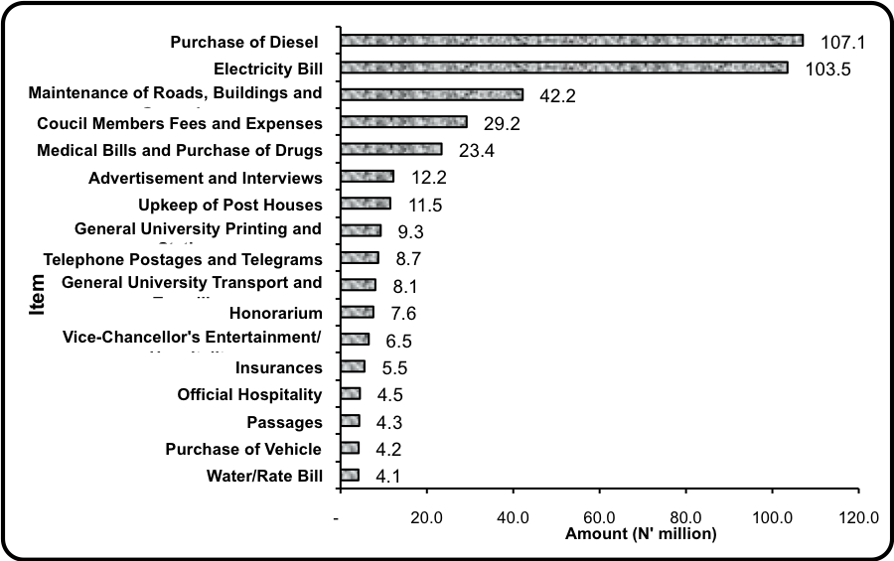
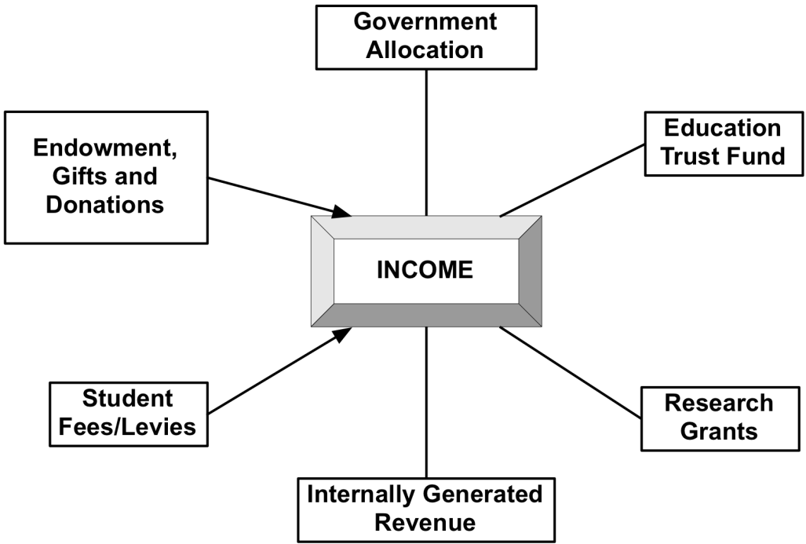
Notes:
Major items of expenditure for universities. Source: Bamiro & Adedeji 2010

Slide 26
Challenges of Funding State Universities-1
There are presently 39 State Universities in Nigeria with all States except Borno, and Zamfara having one and with some States (Ekiti, Ogun, Ondo, Rivers and Kano) having two each.
Although States appear to be eager to set up their own Universities, they are not as enthusiastic when it comes to funding them.
In most States, the University operates from a sub-standard Campus, usually a converted secondary school and the State Government only pays the wage bill of the University and then makes funds available only on a fire brigade approach basis, eg for accreditation.

Slide 27
Challenges of Funding State Unviersities-2
Consequently, the University often has to resort to self-help to survive, leading to the charging of illegal fees, lack of transparency in financial management and academic corruption on the part of academic staff
State Universities consistently fall behind Federal Universities in terms of funding and performance in accreditation.
Indeed, overall, even Private Universities appear to be better off in accreditation performance than State Universities, and this is directly traceable to the State Universities’ poorer resource base.

Slide 28
Challenges of Funding State Unviersities-3: Take-Off Funds
The quantum of funds needed for the take-off of a new State University is truly mind-boggling.
Katsina State spent N11 billion to provide state-of-the art buildings and equipment and meet initial staff development costs in its first three years.
This is a unique and ideal model which is without precedent and is worthy of emulation.

Slide 29
The Role of TETFUND in Funding Tertiary Institutions
TETFUND has become much more than an intervention agency in Nigerian tertiary education: it is now the main provider of capital funds for the public tertiary institutions
Between 2006 and 2010, TETFUND allocated N48.5 billion to public universities, polytechnics, monotechnics and colleges of education
This came to an average of N2.76 billion per annum for all the polytechnics, N2.08 per annum for all colleges of education and N4.26 per annum for all universities

Slide 30
FUNDING IN PRIVATE UNIVERSITIES-1
Private universities in Nigeria generate their funds mainly through tuition fees and other charges which range from about N200,000 to N3,000,000 per student per annum
In the best of the private universities, the American University of Nigeria, which is also the most expensive, the Proprietor, who does not interfere with the management of the University, provides an annual subsidy to make up for the funding shortfall and help to balance the University’s account.

Slide 31
FUNDING PRIVATE UNIVERSITES-2
In the worst of them, the Proprietor is the sole signatory to all the University’s revenue accounts and while paying staff salaries promptly, exercises capricious discretion in the way he provides funds for the running of the University, most of the time over the head or behind the back of the Vice-Chancellor and the Bursar who become helpless onlookers as the Patriarch runs his financial empire
Consequently academic consumables are almost non-existent and there is chronic under-staffing and deep-seated discontent on the part of the staff

Slide 32
Conclusion-1
Federal and State tertiary institutions should enjoy not only administrative autonomy but financial autonomy as well. They should receive recurrent grants that meet the optimum requirements of accreditation and capital grants that can guarantee the provision of world-class teaching and learning facilities
Private institutions, especially universities, need to be more closely monitored to tackle the serious issues of corporate governance that are capable of destroying some of them

Slide 33
Conclusion-2
Management training should be institutionalized for academic leaders in the tertiary institutions.
Tuition fees should be re-introduced in Federal universities along with appropriate safety nets to protect the vulnerable
In view of some of the anomalies highlighted in this presentation, the mechanism for institutional accreditation by NUC should be strengthened to include a detailed verification of management and funding performance indicators which can be used to impose appropriate sanctions on those which fail to meet the minimum prescribed management and funding standards.

