Slide 1
Integrity in Teaching & Learning
Adesegun Fatusi
College of Health Sciences
Obafemi Awolowo University,
Ile-Ife, Nigeria
ICPC Academy, July 2015

Slide 2
Facets of the Challenge
Facing the Future
Framing the Agenda
Outline
Final Words

Slide 3
What are our higher institutions for?
What is our purpose as academics?

Slide 4
What are higher institutions for?
“I work in the knowledge and human-resource industry. My company specialises in two kinds of product: we manufacture high-quality multi-skilled units of human capacity; and we produce commercially relevant, cutting-edge new knowledge in user-friendly packages of printed materials” – Stefan Collini, 2012
Notes:
What are universities for? Stefan Collini, 2012. Penguin Books, London

Slide 5
The relevance of the topic -1
“When the factory for producing present work-force and leaders of tomorrow became greatly compromised in its natural role, something drastic is needed to be done to rectify the decay and secure the future of our nation, and very fast too”
- ICPC & NUC
(Univ. System Study & Review [USSR]), pg. 15
http://connectnigeria.com/articles/2014/02/06/of-winners-and-losers-of-asuu-strike/

Slide 6
The relevance of the topic- 2
Honesty and integrity are absolutely essential for success in life – all areas of life. The really good news is that anyone can develop both honesty and integrity
- Zig Zigler

Slide 7
Framing the Agenda

Slide 8
What is integrity?
The quality of being honest & having strong moral principles
The state of being whole ..
- Oxford Dictionary

Slide 9
What is integrity? (2)
"Integrity is not a conditional word. It doesn't blow in the wind or change with the weather. It is your inner image of yourself, and, if you look in there and see a "person" who won't cheat, then you know you never will" --John D. MacDonald
Real integrity is doing the right thing, knowing that nobody's going to know whether you did it or not -- Oprah Winfrey

Slide 10
Integrity & the Academia..
Academic integrity is the moral code or ethical policy of academia This includes:
Avoidance of cheating or plagiarism
Maintenance of academic standards
honesty and rigor in research and academic publishing
- Alison Kirk (1996-11-30), Learning and the marketplace, (cited in https://en.wikipedia.org/wiki/Academic_integrity)

Slide 11
Academic integrity: fundamentals
..Academic integrity = Commitment to five fundamental values:
honesty,
trust,
fairness,
respect, and
responsibility. …
Int’l Center for Academic Integrity
http://www.uwo.ca/tsc/resources/pdf/CAI-fundamental-values.pdf
“Without them, everything that we do in our capacities as teachers, learners, and researchers loses value and becomes suspect. When the fundamental values are embraced, utilized, and put into practice they become touchstones for scholarly communities of integrity”.

Slide 12

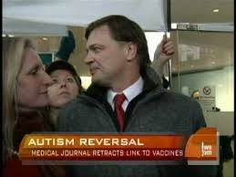
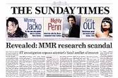
“Integrity in Teaching & Learning” - a “second-rated” agenda?

Slide 13
“Teaching & Learning” are really the original mission of academic institutions….
“Research has not always been a key function of academic institutions
…. In fact, the contemporary research university dates back only to the beginning of the 19th century… Before that, universities were largely devoted to teaching
and to the preparation of professionals” (pg. 14)
And remain critical to their future & impact, including increasing research capacity

Slide 14

The Teacher is Central to the Educational Enterprise
“Teaching/learning has the teacher as its fulcrum …. Many studies have reported strong and positive relationship between what the teachers do and how they do these, on the one hand, and their students’ achievements or learning outcomes on the other hand”
- Olorundare, 2003
(The teaching profession: ethics and problems)

Slide 15
The integrity of the teacher is integral to good teaching
“Good teaching cannot be reduced to technique; good teaching comes from the identity and integrity of the teacher.”
“If we want to grow as teachers -- we must do something alien to academic culture: we must talk to each other about our inner lives.”
  ― P.J. Palmer (The Courage to Teach: Exploring the Inner Landscape of a Teacher's Life)
No education system can rise above the quality of its teachers – NPE (2004)
Notes:
Parker J. Palmer (The Courage to Teach: Exploring the Inner Landscape of a Teacher's Life)

Slide 16
Core Forces in Shaping Integrity in Educational Institutions
Env.
Teacher
Learner
Level of integrity in teaching & learning in an academic institution

Slide 17
The Teacher’s Dynamics in “Teaching and Learning” Integrity Landscape
What the
Teacher Teach
How the
Teacher Teach
The Faithfulness with
which Teaching is Done
The Quality of the
Teacher’s Assessment
Notes:
.
Health services may be delivered in a way that adolescents do not want to obtain them, even if they can. One common reason for this is that they have to go to and wait in a place where they could be seen by people who they know. Other reasons are the fear that health workers will scold them, ask them difficult questions, and put them through unpleasant procedures; or that health workers will not maintain confidentiality. What this means is that the health services are not acceptable to them.
Finally, health services may be 'friendly' to some adolescents, such as those from well to do families, but may be decidedly 'unfriendly' to others, such as young people living and working on the streets. In other words, they may be available, accessible and acceptable but not necessarily equitable.
Not surprisingly, in many parts of the world, adolescents are reluctant to seek help from health facilities. If and when they do seek help, they are more often than not likely to leave discontented and unhappy with the way in which they are dealt with, and determined not to go back, if they can help it.
Equitable: All adolescents, not just certain groups, are able to obtain the health services they need.
Accessible: Adolescents are able to obtain the services that are provided.
Acceptable: Health services are provided in ways that meet the expectations of adolescent clients.
Appropriate : The health services that adolescents need are provided.
Effective: The right health services are provided in the right way and make a positive contribution to the health of adolescents

Slide 18

Ethical Principles in Higher Education Teaching
1. Content Competence
2. Pedagogical Competence
3. Dealing with Sensitive Topics
4. Student Development
5. Dual Relationships With Students
6. Confidentiality
7. Respect for Colleagues
8. Valid Assessment of Students
9. Respect for Institution
Source: The Society for Teaching & Learning in Higher Education
http://www.uwo.ca/tsc/resources/pdf/EthicalPrinciples.pdf

Slide 19
facets of the challenge

Slide 20
As teachers, professors encourage the free pursuit of learning in their students. They hold before them the best scholarly and ethical standards of their discipline. Professors demonstrate respect for students as individuals and adhere to their proper roles as intellectual guides and counselors. Professors make every reasonable effort to foster honest academic conduct and to ensure that their evaluations of students reflect each student’s true merit - AAUP

Slide 21
Practical implications: key questions
Are lecturers assigned to teach in areas of competency?
Are lecturers developing and improving themselves?
Do lecturers model ethically-sound practices in the use of the intellectual product of other people?
Do our classroom sessions ensure optimal interaction with opportunity for questions & different views?
Do our teaching methods & approaches maximize learning & optimally prepare students for the future
Are students gaining required knowledge, aptitude & skills that prepare them adequately for future success?
Are grading system fair & fairly applied?
Is our relationship with students ethically sound – devoid of intimidation, harassment, corruption & shady dealings

Slide 22
Ethical issues and integrity in teaching & learning in Nigerian higher institutions:
Reflections from the Univ. System Study & Review (USSR)

Slide 23
Findings -1: Teaching Activities
Poor level of preparedness & low competency
Lack of commitment to work by the lecturers.
  “Academic staff ...leave their duty any time in the pretext of doing research work”.
  “Lecturers prefer to only lecture nowadays as against the former practice where lecturers engaged in a little bit of teaching which give ample opportunity for students to comprehend what the lecturers said.”.
  “Lecturers holding two permanent appointments in two different universities”
Lack of staff motivation.

Slide 24
Findings - 2: Teaching/Learning Management System
Distribution of teaching load and other faculty assignments on basis of friendship & patronage
Inadequate monitoring of lecturers by HODs
Unchecked selling of handouts by lecturers
Inadequate sanction of violators of code of conducts & staff engaged in unethical practices
Absence of effective institutional mechanism for monitoring teaching effectiveness
Lack of adequate measures in place to check examination malpractices.

Slide 25
Findings - 3: Unhealthy Relationships
Material Inducement, e.g. selling of examination questions & gift-induced allocation of marks
Sexual alliances – “The so-called ‘Professors' release examination questions to their girl friends before exam. They should be punished” – USSR pg 30
Sexual coercion & harassment of students
Psychological violence, including bullying
Use of students intellectual products unethically

Slide 26
Findings 4- Facilities & Structural Issues
Non-adherence to students/lecturer ratio results in over-crowding of classes.
Lack or inadequacy of facilities
.

Slide 27

Impact of compromising integrity in teaching & learning
frustrated, dis-oriented and disillusioned citizenry, especially poorly prepared graduate, especially the poorly educated youth who are either unemployed or made unemployable.
Compromised integrity in higher education = Compromised future for educ. system, graduates & nation

Slide 28
Putting the future into focus…
With the right policies for the next generation, Nigeria’s aspiration to become one of the world’s largest 20 economies is within reach. If Nigeria’s leaders make the wrong choices today, the country will suffer the consequences for many decades to come – and Nigeria’s development breakthrough could be forever lost.

Slide 29
Facing the future

Slide 30
The time is always right to do what is right
- Martin Luther King Jr.

Slide 31
Framework for strengthening higher academic institutions
Human Resources
Resources & Facilities
Performance of academic institutions
Governance
The ESSENTIAL Catalyst:
Leadership vision & action
Adapted from Altbach & Salmi (eds), 2009
Notes:
Adapted from Salmi, 2009

Slide 32
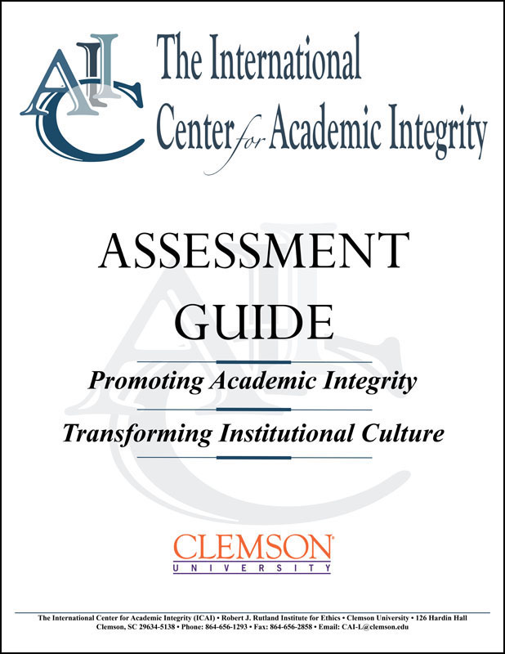
1. Assess & Document the Challenge
Critically assess & analyse the elements and dynamics in the teaching-learning relationships
  Governance structure
  Human resources
  Resources and facilities

Slide 33
Integrity in Teaching & Learning: Stages of Institutional Development
Stage One: "Primitive" | An institution with no policy or procedures (or minimalist ones) and where there is great variation in faculty and administrative handling of cheating.
Stage Two: "Radar Screen" | An institution where cheating issues have risen to public debate because of the perceived weakness of academic integrity policies and fundamental concerns with the consistency and fairness of existing practices.
Stage Three: "Mature" | An institution where academic integrity policies and procedures are known and widely, but not universally, supported. Continuing efforts occur to socialize new faculty and students to the academic integrity policy, and it is used frequently by faculty, in particular.
Stage Four: "Honor Code" | An institution where both staff & students take major responsibility in implementing the integrity policy, and there is high fidelity in implementing the policy
Adapted from: Gary Pavela (Model code of academic integrity). http://www.academicintegrity.org/icai/resources-4.php

Slide 34
2. Build & Implement Evidence-based & Robust Interventions
Governance structure:
  Anonymous & compulsory students’ assessment
  Strengthen monitoring of teaching
  Ensure regular curriculum review
  Review, revise & enforce code of conduct
Human Resources
  Build capacity of lecturers in teaching effectiveness
  Formal academic mentoring of young faculties
Resources & Facilities
  Improve facility for teaching
  Provide IT-resources to check plagiarism

Slide 35
3. Cultivate the Culture of Integrity
Share the results students’ assessment and appropriately use it in staff promotion
Institute awards & publicly honour outstanding teachers & students on regular basis
Vigorously support the quality assurance system
Upgrade facilities regularly & use IT to drive integrity-related changes
Ensure continuous training of staff and students on issues of academic integrity
Encourage reporting of integrity breaches & protect & celebrate “whistle blowers”

Slide 36
Case Reflection: what will we like our campuses to be in the coming years?
An atmosphere of intellectual excitement
An intensive research and knowledge transfer culture permeating all teaching and learning activities
Clear academic expectations and standards
Premium quality learning spaces, resources and technologies
An adaptive curriculum
http://www.cshe.unimelb.edu.au/resources_teach/framework_teach/docs/9principles.pdf

Slide 37
Final words

Slide 38
“While the system may be in place and even punish wrongs, ultimately, integrity is a personal choice that every human being must make. And in no other place than the citadel of learning, where the destiny of a people or a nation is moulded, is this more imperative.
INTEGRITY MUST RETURN TO SCHOLARSHIP”
-Guardian, 9 June 2013

Slide 39
Teaching & Learning… it’s all about integrity
The greatest of a man is not in how much wealth he acquires, but in his integrity and his ability to affect those around him positively
  - Bob Marley
If you have integrity, nothing else matters. If you don't have integrity, nothing else matters
- Alan Simpson
Notes:
“To educate a person in mind and not in morals is to educate a menace to society.”
–Theodore Roosevelt

Slide 40
Our Sacred Task…
Promoting and protecting academic integrity in all its ramifications is the responsibility of EVERY member of the campus community

Slide 41
Thank you

